Slide 1


















Introduction to CRM
Customer Relationship Management (CRM) is a strategy for managing all your company's relationships and interactions with your customers and potential customers. It helps you improve your profitability.
CRM is a strategy and technology that is used to build stronger relationships between organizations and their clients. An organization will store information that is related to their clients, and employees will analyse it to use it in forecasting and making reports.
CRM enables you to focus on your organization's relationships with individual people – whether those
are customers, service users, colleagues or suppliers.
Customer Care
Workflow Automation HR Management
Marketing
Sales
CRM
System
Lead Management
Salesforce Automation
Support
Analytics
Business Reports
Orders
Marketing

Slide 2
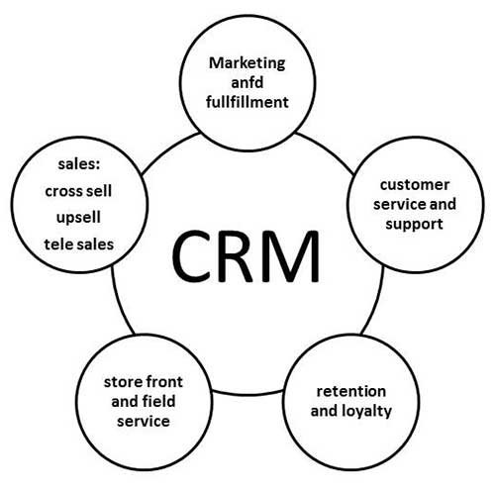
2. CRM Scope:
Customer Data Management: Collect, organize, and analyze customer data to gain insights and make informed decisions.
Sales Management: Track and manage sales leads, opportunities, and customer interactions.
Marketing Automation: Targeted marketing campaigns, lead nurturing, and ROI analysis.
Customer Support: Manage customer inquiries, complaints, and support requests efficiently.
Analytics and Reporting: Utilize data to make data-driven decisions and measure CRM's impact.

Slide 3
3. Importance of CRM:
Enhanced Customer Relationships: CRM helps build stronger, more personalized customer relationships.
Increased Sales: It enables better lead management, sales forecasting, and pipeline visibility.
Efficient Marketing: Targeted campaigns, lead scoring, and automation improve marketing efficiency.
Improved Customer Service: Streamlined support processes lead to higher customer satisfaction.
Data-Driven Decision-Making: Data analytics provide insights for strategic decisions.

Slide 4
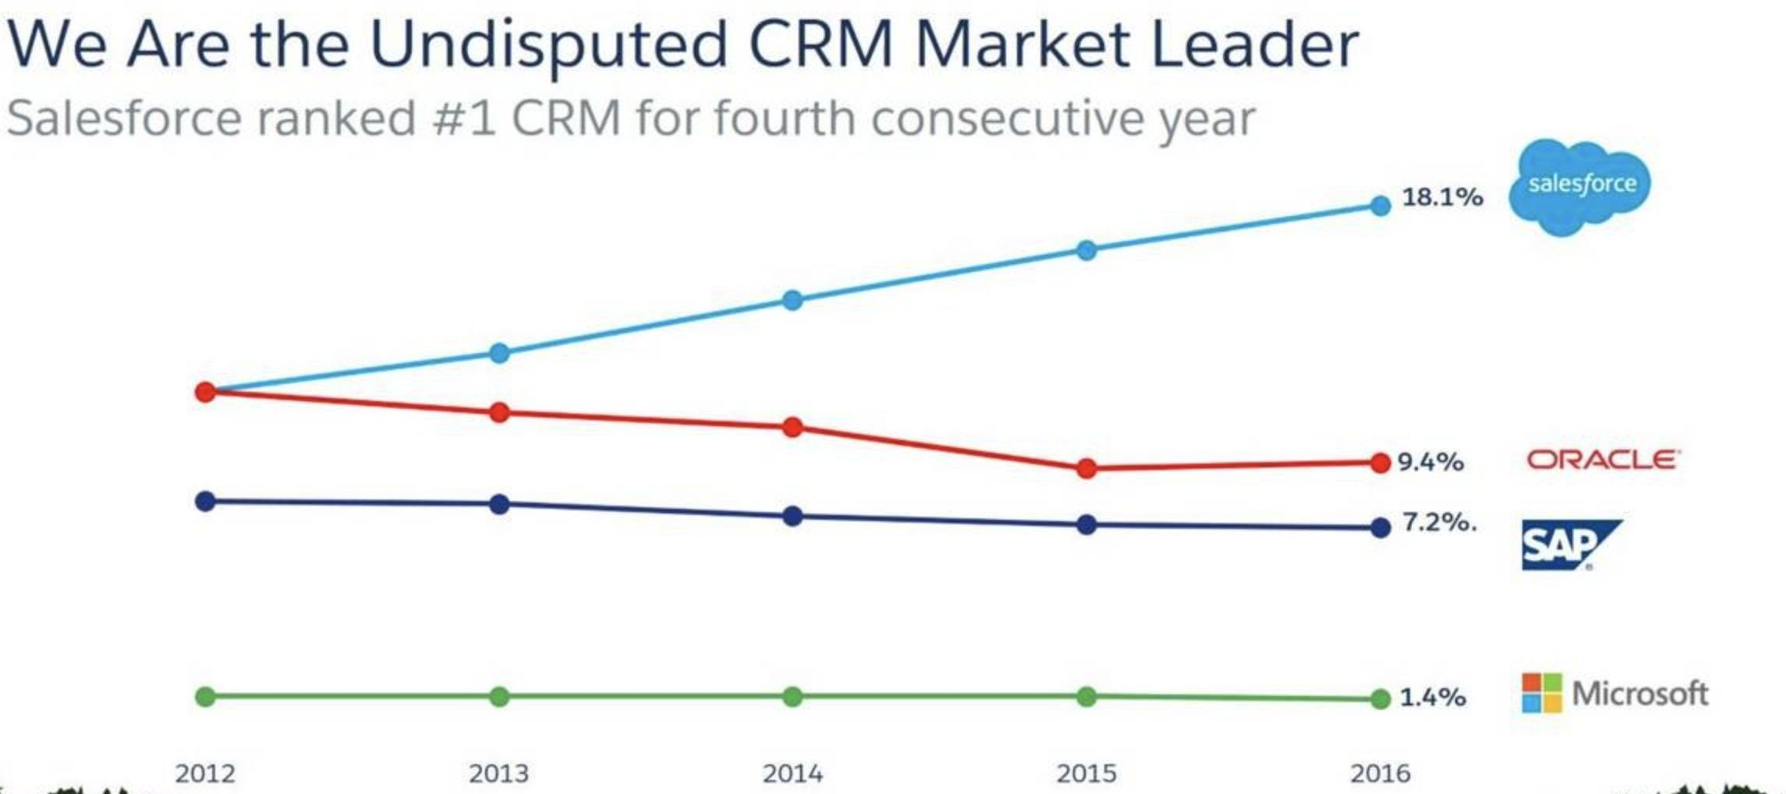
4.Introduction to Salesforce CRM ( On Demand)
Salesforce.com is a cloud computing and social enterprise software-as-a-service (SaaS) provider based in San Francisco. It was founded in March 1999, in part by
former Oracle executive Marc Benioff.
Salesforce is the world's #1 Customer Relationship Management (CRM) platform. Our cloud-based applications for sales, service, marketing, and more don't require IT experts to set up or manage — simply log in and start connecting to customers in a whole new way.
Salesforce is cloud based CRM software, developed to make organizations function efficiently and profitably by reducing the cost of managing hardware infrastructure. Salesforce offers a wide range of features in all the functional areas of a company.

Slide 5
Objects in Salesforce…
Objects - Object like a table or entity in standard database terms which allows us to store the data specific to organization in salesforce.
Data in salesforce is stored as objects .There are 3 types of Objects In Salesforce
1) Standard Objects 2) Custom Objects 3) External Objects
Standard Objects:
Objects already created for you by Salesforce are called standard objects Examples like Account, Contacts, Opportunities, Leads
Standard objects can be customised to a limited extent.
External Objects :
External objects are similar to custom objects, but external object record data is stored outside your Salesforce organization. For example, perhaps you have data that’s stored on premises in an enterprise resource planning (ERP) system. Instead of copying the data into your org, you can use external objects to access the data in real time via web service callouts.
External objects are identified with x suffix

Slide 6

Objects in Salesforce…
Custom Objects: These are the objects that you create in Salesforce. They have full customisation capability.
You can use custom objects to extend Salesforce functionality or to build new application functionality
You can choose whether your custom objects are searchable, support sharing, or include access to the Bulk API and Streaming API support reporting Field Tracking etc.
While creating custom object you can select Deployed/In development mode. If you select Deployed mode then the object is available to all users. If you select In-Development mode then the object is available only to System Admins
Custom objects are identified with c suffix.
To create custom object—Setup=>Build=>Create =>Object
Follow this path – Setup – Build- Create – Objects– Click on new custom object button and enter label name, plural label and object name and also enter Record Name as data type.
To create record name there are two types of data types.
TEXT
Auto Number

Slide 7

Objects in Salesforce…
We have also a optional feature while creating objects-
Allow reports: If we verify this check box then only these objects are available to make reports.
Allow Activities: If we verify this check box then we are able to make activities on this object.
Track Field History: When we verify this check box then merely we are to track fields. We can track up to 20 fields for single object.
In development: If we verify this check box, then this object is still in development mode. This is not present for deployments.
Deployed: After selecting this check box then only it will be available for deployment. The following options are available only when creating custom object first time.
Add notes and attachments related list.
Launch new custom tab wizard after saving this custom object.
▪

Slide 8


Objects in Salesforce
After completing all the details press the save button.
If we does not select “Launch new custom tab wizard” from object creation page, then the object would save without tab appearance. According to this case firstly we have to make tab for this object. If we select this check box the object would save and tab would be created and appeared.
Difference between standard and custom objects
Standard objects are limited to a standard set of fields; custom objects are made up of custom fields.
Standard objects include standard layouts; custom objects allow you to change their layouts.
Standard objects are included with Salesforce by default; custom objects are objects that you create in your organization.

Slide 9
Fields
Fields are analogous to columns in databases .You have standard fields and custom fields
Standard Fields or System Fields are not editable except the label
Custom Fields are editable to a greater extent
Create “New” Custom Field: The location of the “New” option may vary depending on the object you use. When using a standard object, go to App Setup > Customize > [Object Name > Fields. With a custom field object, find App Setup > Create > Objects. You will see the “New” option on the right next to “Custom Fields & Relationships” when you scroll down to the Custom Fields section. Select “New” to create a new custom field.
Assign a Field Type: When setting up a custom field in Salesforce, you must define a field type—each field in Salesforce must have a type (e.g., number, text).
Field types designate how users view and interact with your data. You can choose from several pre-determined field types.
There are a limited number of fields to choose from when creating custom fields versus the full set of field types in Salesforce, as many are only an option when using standard objects. (For relationship fields [lookup, master-detail], you will need to follow more detailed instructions than covered in this post).
Define Field Attributes: You will need to define attributes for each field that you create in Salesforce. Defining attributes is a critical step to using fields properly. Make sure you recognize the various attribute options before setting up fields. While attributes may vary based on field type and certain attributes may not be available depending on the specific field type, the most popular attributes include: field label, field name, help text, required, unique, external ID, and default value.

Slide 10
Introduction to Data Types
Field Type | What the Field Contains
Formula | A read-only field that derives its value from a formula expression you define. The formula field is updated when any of the source fields change.
currency | Allows users to enter a dollar or other currency amount and automatically formats the field as a currency amount.
email | Allows users to enter an email address, which is validated to ensure proper format.
encrypted | Encrypted text fields contain any combination of letters, numbers, or symbols that are stored in encrypted form. You can set a maximum length of up to 175 characters.
location | A compound data type that contains latitude and longitude values for geolocation fields.
multipicklist | Multi-select picklists, which include a set of enumerated values from which multiple values can be selected.
percent | Allows users to enter a percentage number, for example, '10' and automatically adds the percent sign to the number.
phone | Phone numbers. Values can include alphabetic characters. Client applications are responsible for phone number formatting.
picklist | Picklists, which include a set of enumerated values from which one value can be selected.
textarea | Allows users to enter up to 255 characters on separate lines.
url | URL values. Client applications should commonly display these as hyperlinks.
Master-Details | Creates a special type of parent-child relationship between this object (the child, or "detail") and another object (the parent, or "master") where:
Lookup | Creates a relationship that links this object to another object. The relationship field allows users to click on a lookup icon to select a value from a popup list.
Auto number | A system-generated sequence number that uses a display format you define. The number is automatically incremented for each new record.
Roll-Up Summary | A read-only field that displays the sum, minimum, or maximum value of a field in a related list or the record count of all records listed in a related list.

Slide 11
Field Dependency
These are filters that allow us to change the content of a picklist based on the value of another field (Checkbox/picklist).
There are two terms used in field dependency:
Controlling Field: The value of this field controls the value of dependent field There can be up to 300 values in a controlling field. A field that is both a controlling field and a dependent picklist cannot have more than 300 values. When a controlling field is modified, no checks are performed on dependent fields. These fields cannot be used as controlling fields.
Dependent Field: The value of this field depends on the value of controlling field.A dependent picklist is a bespoke or multi-select picklist whose permitted values are determined by the value of another field known as the controlling field. On the same record, controlling fields can be any picklist (with at least one and no more than 300 values) or checkbox field.rvin® All Rights Reserved

Slide 12




Introduction to Relationships
When two objects are related together by a relationship field. This allows you to associate related information easily between objects.
All relationships maintain some form of a parent-child relationship. This can be thought of as a hierarchical structure where one object looks up to the other, and as such, you only need to create one relationship field.
You create a relationship field in the child object. In order to determine the parent, you need to consider which object is dependent on the other and how many records of both objects could possibly be related to each other in your data model.
There are two main categorizing relationships: either a “one-to-many” or “many-to-many”
relationship.
Lookup and master-detail, have unique characteristics regarding how they handle data deletion, record ownership, security, and required fields. When deciding between these two types of relationships, you need to think about which type of field will hold the kind of functionality you are looking for.

Slide 13



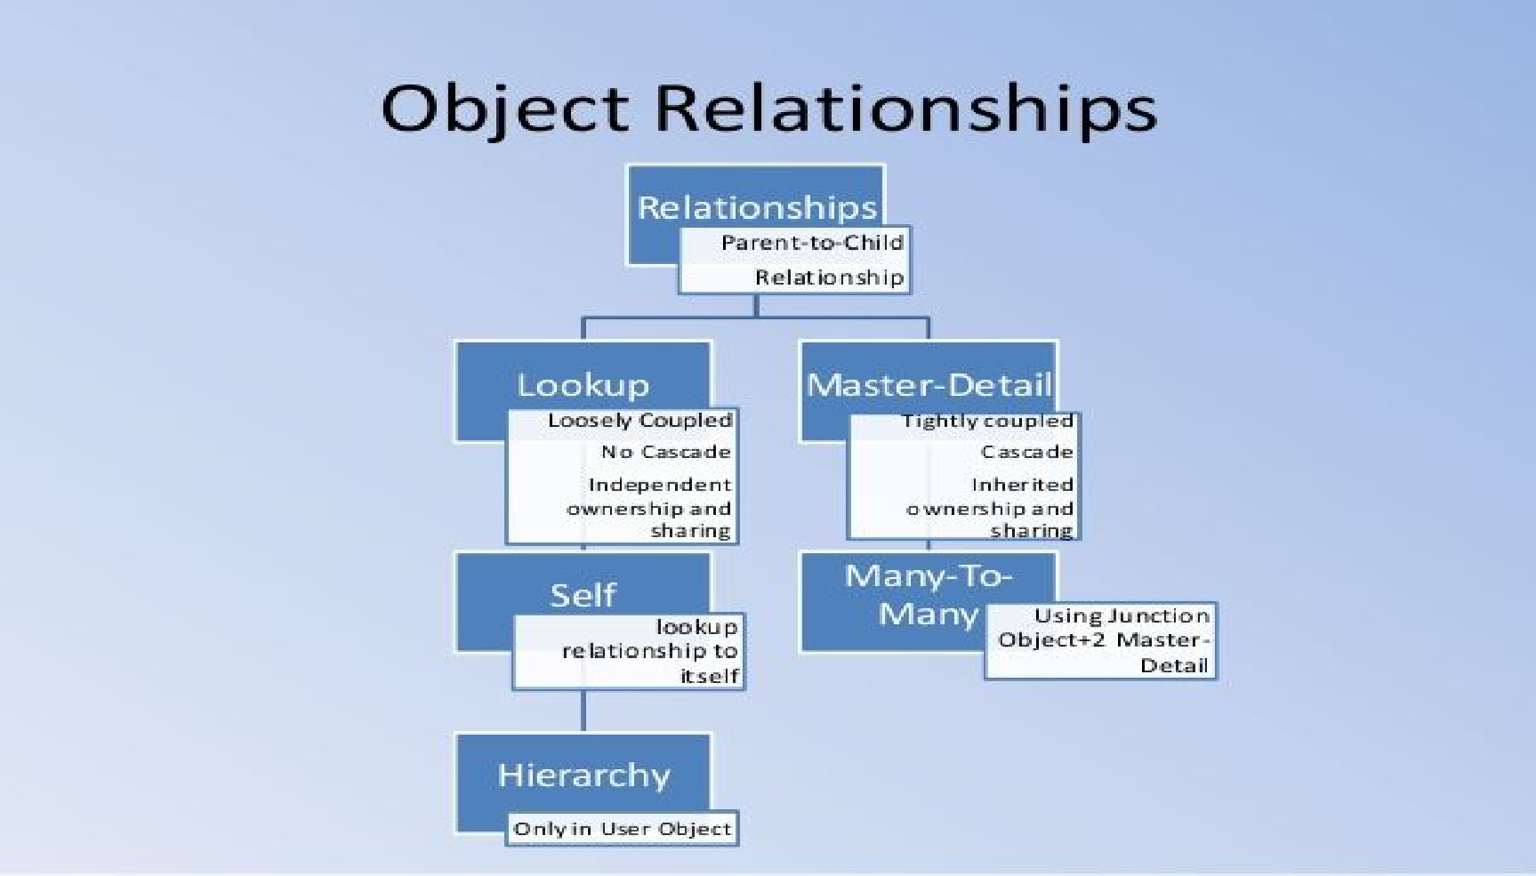


Types of Relationships in Salesforce
Master – Detail Relationship
Lookup Relationship
Many-to-Many Relationship

Slide 14



Master-Detail Relationship…
Master Detail Relationship is a one to Many Relationship
Here the Master object controls certain aspects of the child object
You can create a Master Detail relationship field on the child that relates to parent
For example :
Lets suppose we have an object A and Object B. We can create a Master-detail field on Object B that references Object A as Parent. Typically the Master-Detail Field on the child is Populated with the corresponding ID of Parent Record
The list of child Records can be seen on Parent Record layouts as “Related Lists”
For example :
You can have all the associated Child Records of Object B as Related List on the Page Layout of Parent Object A record

Slide 15


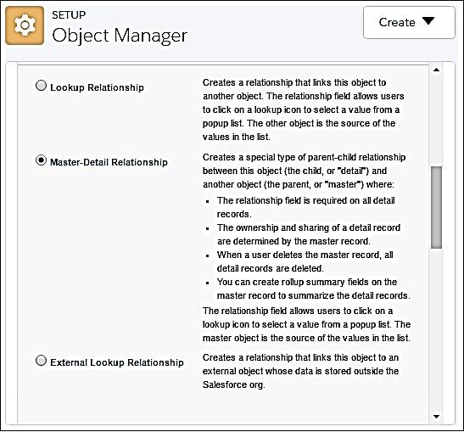
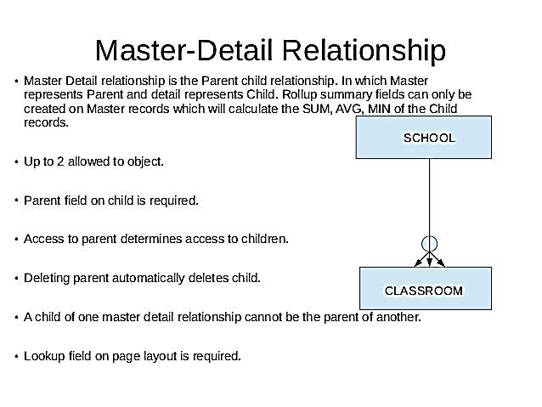
Master-Detail Relationship….

Slide 16

Features of Master –Detail Relationship
A parent-child relationship in which the master object controls certain behaviors of the detail object
When a parent master record is deleted all its child records are deleted
Child Records inherit the sharing & Security of its Master Record
The master-detail relationship field is required on the page layout of the detail record
Master –Detail relationship allowed Up to 2 allowed to object.
Parent field on child object is required.
Lookup field on page layout is required in detail object.
We can not create record master detail relationship on existing record.
A child of one master detail relationship cannot be the parent of another.
You can define master-detail relationships between custom objects or between a custom object and a standard object. However, the standard object cannot be on the detail side of a relationship with a custom object
Both the master and detail records are automatically included in the report record types.
By default, records can’t be reparented in master-detail relationships. Administrators can, however, allow child records in master-detail relationships on custom objects to be reparented to different parent records by selecting the Allow reparenting option in the master-detail relationship definition.
The Owner field on the detail object is not available and is automatically set to the owner of its associated master record. Custom objects on the detail side of a master-detail relationship cannot have sharing rules, manual sharing, or queues, as these require the Owner field.
You can create rollup summary fields on the master record to summarize the detail records.

Slide 17


Lookup Relationships
Lookup Relationship is also a one to many Relationship
But here the Parent Doesn’t have much Control over the child
You can create a Lookup relationship field on the child that relates to parent
For example : Lets suppose we have an object A and Object B. We can create a Lookup Field on Object B that references Object A as Parent. Typically the Lookup Field on the child is Populated with the corresponding ID of Parent Record
The list of child Records can be seen on Parent Record layouts as “Related Lists”
For example: You can have all the associated Child Records of Object B as Related List on the Page Layout of Parent Object A record

Slide 18
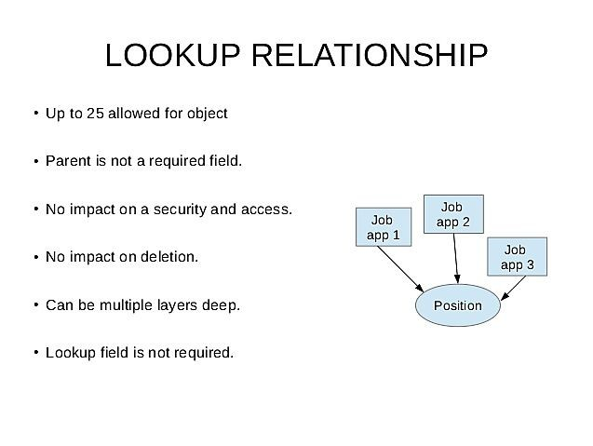

Features of Lookup Relationship
Deletion of Parent Record in a Lookup Relationship doesn’t have any effect on the associated child Records
Child Records do not inherit the sharing & Security of its Master Record
The Lookup relationship field may or may not be required on the page layout of the detail record
You cannot create Roll up Summary Fields on Master Object in Lookup Relationship
You can create Up to 40 allowed for object.
A lookup relationship Can be multiple layers deep.

Slide 19
Difference between master -detail and lookup relationship
Master-detail relationship | Lookup relationship
You can define master-detail relationships between custom objects or between a custom object and a standard object (standard object must be the parent). | You can define a relationship between any two objects, standard or custom.
When a parent record is deleted, all the records in the detail object (child record) that are related to that master record will be deleted. | When a parent record is being deleted, you can configure a child object to either clear the parent record value in the child record or prevent deletion of the parent record.
All child records must have a related parent record(required field). | The parent record may not require a related parent record.
The ownership of the child record is determined by the related parent record. Child records do not have an owner. | Each child record has an owner and is not related to the parent record.
The child record inherits sharing and security from the master record. | There is no security or inheritance between related parent and child records.
To relate an object to another object, no records should exist in the child object. | To relate an object to other objects, there is no condition on the number of records.
If you have the Roll-Up Summary field in the parent object, any create, edit, or delete action in the child record will trigger an edit action in the parent object. | You cannot create the Roll-Up Summary field in the lookup relationship.
Supports cross-object workflow. You can configure a field update action to update a field in the parent record using a value from the child record. | Does not support cross-object workflow.

Slide 20
Many to Many Relationship
Many to Many Relationship in Salesforce can be achieved using Junction Object
You use a junction object to create Many to Many Relationship. A junction object is a custom
The first Master detail Relationship you create is called Primary Relationship and second one
The Junction object Inherits the Look and Feel, Sharing and Security settings from the Primary

Slide 21

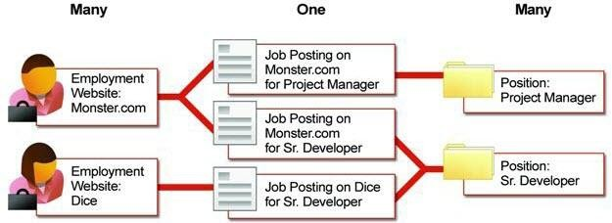
Many to Many Relationship
Junction Object C
Object A
Object B

Slide 22

Roll up Summary Fields…
Roll up Summary Fields can Be created on the Master Object in a Master Detail Relationship
With Roll up Summary Fields You can summarise the child Records. The available summary options are
Count: Get a count of the number of Child Records
SUM: Get the summation of a Field value in all Child Records MIN: Get the Minimum value of Field amongst all Child Records MAX: Get the Maximum value of Field amongst all Child Records
Roll up Summary Fields are available only in Master-Detail Relationship
Number, currency, and percent fields are available when you select SUM as the roll-up type.
Number, currency, percent, date, and date/time fields are available when you select MIN or MAX as the roll-up type.
When you delete a child record on a roll-up Summary field, Salesforce doesn’t recalculate the value of the field. Select the Force a mass recalculation on this field option on the edit page of the roll-up summary field to manually recalculate the value.

Slide 23


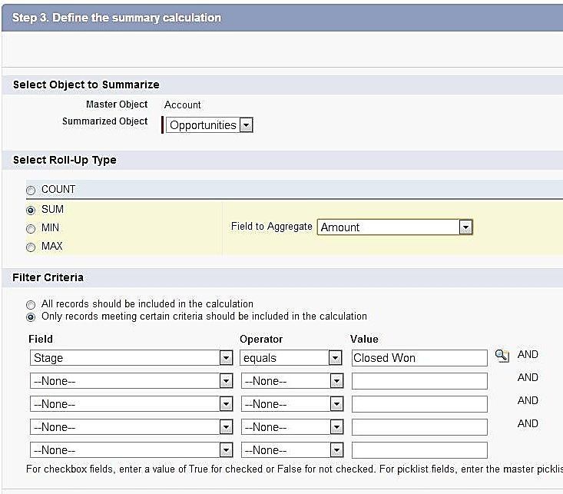
Roll up Summary Fields
You can’t use long text area, multi-select picklist, Description fields, system fields like Last Activity, cross-object formula fields, and lookup
fields in the field column of roll-up summary filters.
Auto number fields are not available as the field to aggregate in a roll-up summary field.
After you have created a roll-up summary field on an object, you cannot convert the object's master-detail relationship into a lookup relationship.
Roll-up summary fields are not available for mapping lead fields of converted leads.

Slide 24



Introduction to Data Migration…
Data Migration in Salesforce refers to importing external data into Salesforce and/or exporting Salesforce Data.
Supported Data Sources include any program that can save data in the csv format
Salesforce offers two main methods of Importing & Exporting data
Data Import Wizard
Data Loader
Steps
Login to your Salesforce developer org
Click “Setup=>Build=>Develop=>Tools

Slide 25
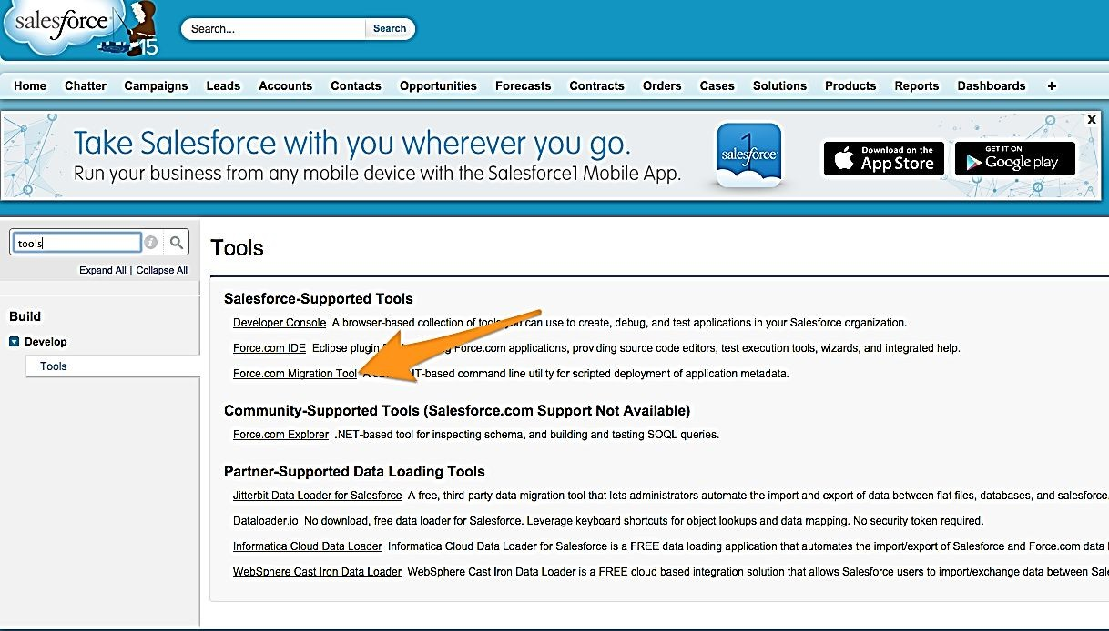
Introduction to Data Migration

Slide 26



Overview of Data Loader & Installation
Data Loader is a client application for the bulk import or export of data. Use it to insert, update, delete, or export Salesforce records. When importing data, Data Loader reads, extracts, and loads data from comma-separated values (CSV) files or from a database connection.
Data Loader can import up to five million records at a time of any data type, either from files or database connection
It can be operated either through the user interface or command line
Data loader uses SOAP API to process records. For faster processing you can configure it to use BULK API instead
To install Data loader Go to setup menu and download Data loader on your computer and install it.
Connect Data Loader to Salesforce using your salesforce credential along with security token.
Available in: Enterprise, Performance, Unlimited, Developer, and Database.com Editions
You can use Data Loader in two different ways
User interface: When you use the user interface, you work interactively to specify the configuration parameters, CSV files used for import and export, and the field mappings that map the field names in your import file with the field names in Salesforce.
Command line (Windows only):When you use the command line, you specify the configuration, data sources, mappings, and actions in files. This enables you to set up Data Loader for automated processing.

Slide 27
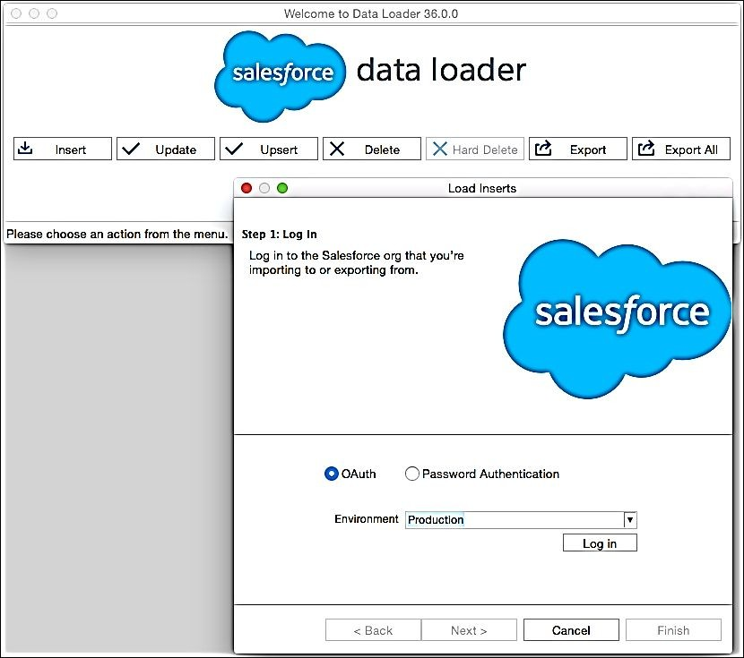

Data Loader key features:
An easy-to-use wizard interface for interactive use
An alternate command-line interface for automated batch operations (Windows only)
Support for large files with up to 5 million records
Drag-and-drop field mapping
Support for all objects, including custom objects
Can be used to process data in both Salesforce and Database.com
Detailed success and error log files in CSV format.
A built-in CSV file viewer.
Support for Windows and Mac.

Slide 28
Things to know about Data Loader
When to Use Data Loader
You need to load 50,000 to 5,000,000 records. Data Loader is supported for loads of up to 5 million records.
You need to load into an object that is not yet supported by the import wizards.
You want to schedule regular data loads, such as nightly imports.
You want to export your data for backup purposes.

Slide 29

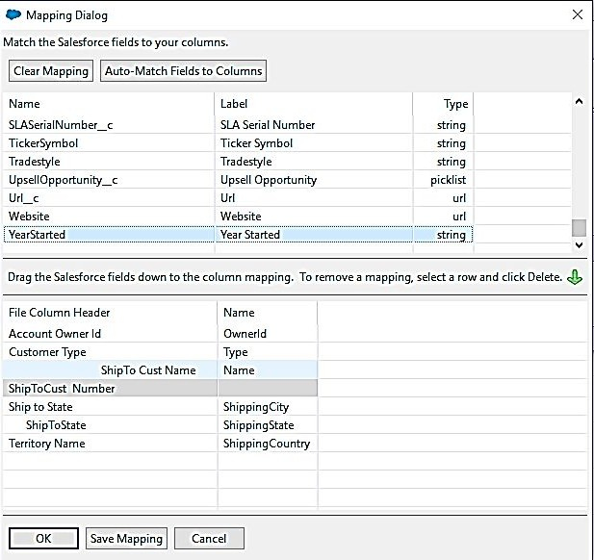
Data loader Action insert/update/upsert/Delete
/Hard Delete…
Click Insert, Update, Upsert, Delete, or Hard Delete. These commands are also listed in the File menu
Enter your Salesforce username and password. To log in, click Log in.
Choose an object. For example, if you are inserting Account records, select Account
To select your CSV file, click Browse. For example, if you are inserting Account records, you could specify a CSV file called insertaccounts.csv containing a Name column for the names of the new accounts
If you are performing an upsert, your CSV file must contain a column of ID values for matching against existing records
Define how the columns in your CSV file map to Salesforce fields.
For each operation, the Data Loader generates two unique CSV log files. A “Success” file for successful record transactions and “error” file for errored out transactions
Delete deletes the record but keeps it in recycle bin which you could restore. Hard Delete completely deletes the record from salesforce.
Additionally using Data Loader you can Export Records From Salesforce to a csv file.

Slide 30
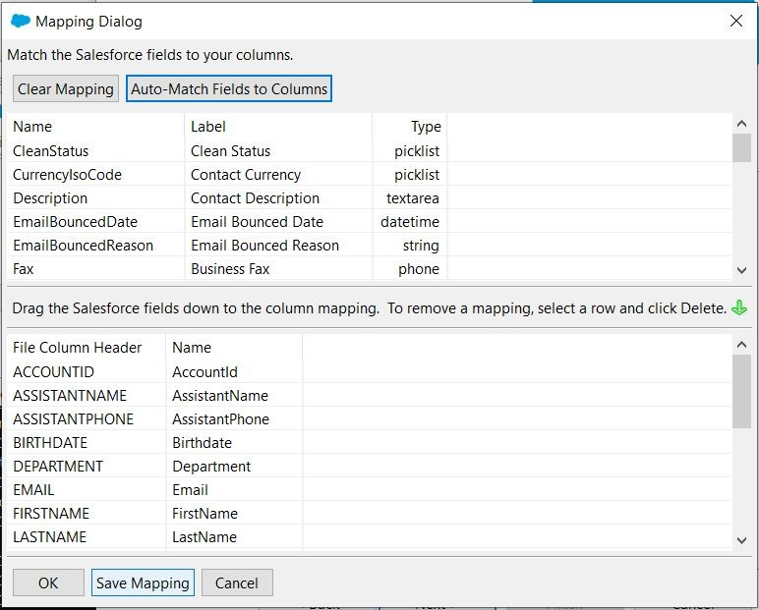
Continue….

Slide 31
Data loader Action insert/update/upsert/Delete
/Hard Delete
Update:
To update the records click on update and login.
Next select the csv file contains updated records with IDs and sect the object and complete the operation.
Upsert:
Upsert also same as update but here we can insert new records also.
By using this operation we can insert new records and update existing new records.
Export:
Export means down loading the data from organization
Click on export button and then login with your credentials.
Select the object you want to export data and specify the folder where you want to save this exported file. And then finish the operation
Export All:
Export All means it will give the data including data in recycle bin.
Delete:
Delete means it will delete data from your organization. To delete the data you want export the existing data with ID’s and then by using this file we can delete the data. The data deleted by this operation will be available in recycle bin. If want delete data permanently choose hard delete option.
Hard Delete
Hard delete means deleting the data permanently from the org. That mean data will not be stored recycle bin. To enable this button enable bulk API. To enable bulk API button go to data loader settings and then enable bulk API
check box.

Slide 32

Salesforce Import Wizard…
Data import Wizard lets you import data in common standard objects & custom objects
It can import up to 50,000 records at a time
It provides a simple interface to specify the configuration parameters, data sources, and the field mappings that map the field names in your import file with the field names in Salesforce.
The standard objects the Import wizard supports are accounts, contacts, leads, solutions, person accounts, or articles.
Use the import wizards when:
You are loading less than 50,000 records.
The object you need to import is supported by import wizards. To see what import wizards are available and thus what objects they support, from Setup, enter Data Management in
the Quick Find box, then select Data Management.
You want to prevent duplicates by uploading records according to account name and site, contact email address, or lead email address.
To navigate data import wizard go to Setup -> Administer -> Data Management -> Data import Wizard and click on Launch Wizard.

Slide 33
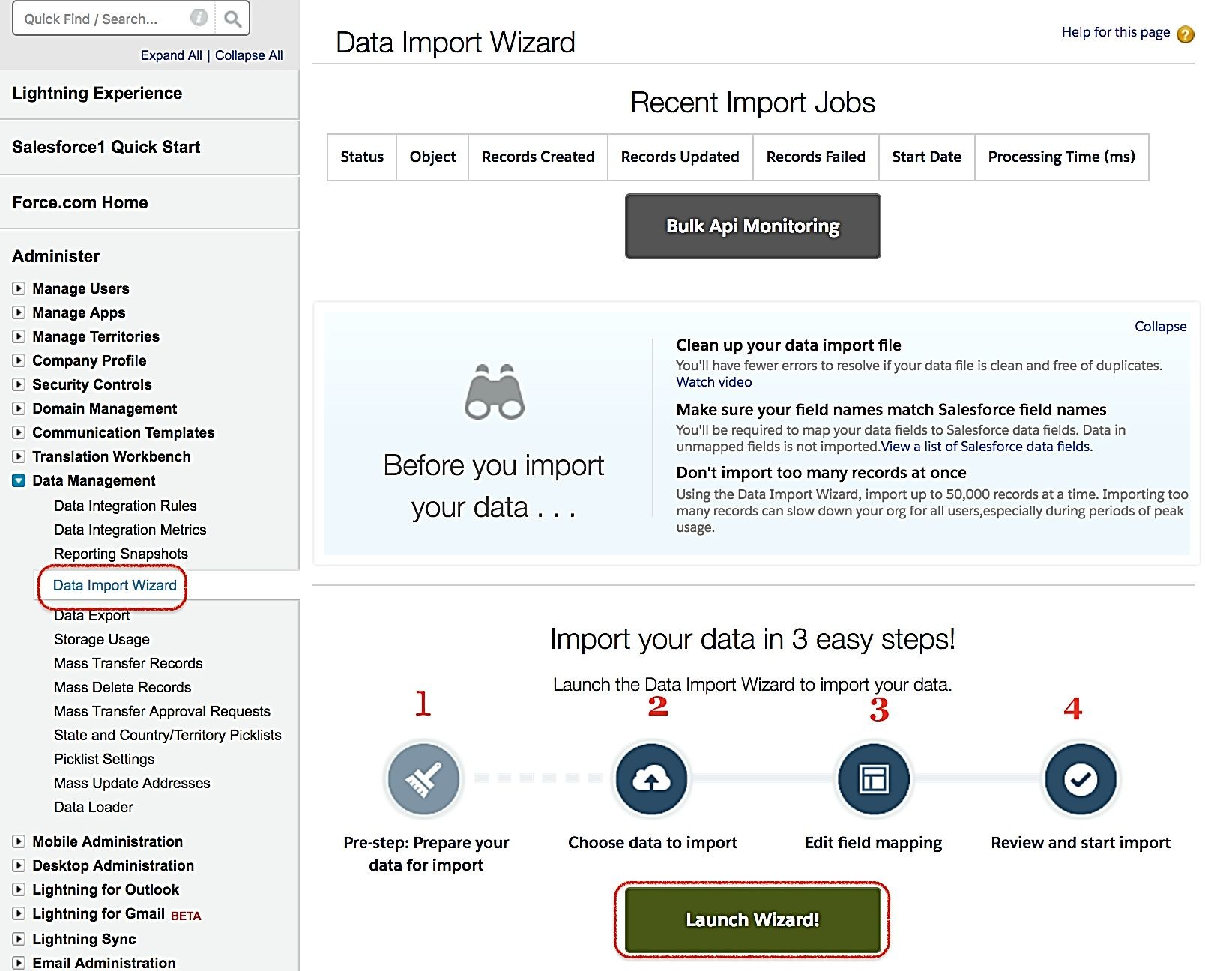
Salesforce Import Wizard

Slide 34
Difference between Data Loader & Import Wizard
Import Wizard | Data Loader
1) Maximum 50,000 records can be Imported | 1) For complex imports of any size more than 50000 records
2) Works on accounts, contacts, leads, solutions, person accounts, articles & Custom Objects | 2) It supports all standard and custom objects.
3) We cannot export data | 3) We can export data of all custom & standard objects, and can import all custom & standard objects except User standard object.
4) Delete operation is not available Data Loader | 4) Delete & Hard Delete is available
5) While importing, duplicates can be ignored. | 5) While importing, duplicates cannot be ignored.
6)It doesn’t support schedule export. | 6)It supports schedule export.

Slide 35
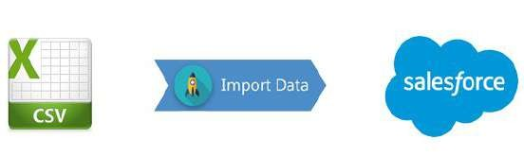
Data Export
Data Export:
Data can be easily exported manually or automatically
Data is exported in the form of .csv files

Slide 36
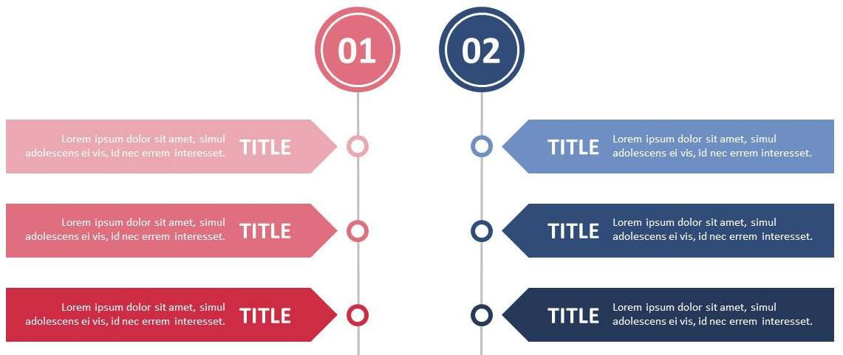
Data Export Methods
Data Export Wizard
Data Loader
Accessible through Setup menu, in-browser wizard
Allows export once every 6 days or 28 days
Using schedule export can be done automatically
It is a client application Can be accessed through user interface or command line
For automatic export using command line is suggested

Slide 37
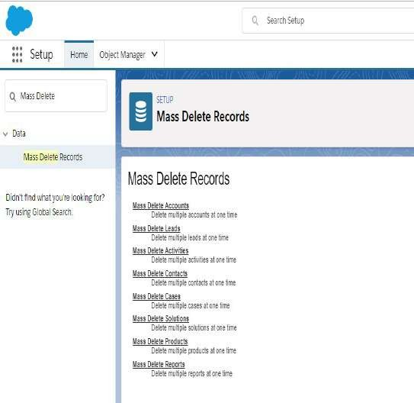
Mass Delete
What is mass delete?
Mass delete allows you to delete data in bulk. Salesforce has introduced the option of mass delete recently. it has certain limitations. You need to have the permission to modify all data, in order to mass delete data in salesforce. you can delete a maximum of 250 data at a time. Only admin can delete data data of
associates cases
partner accounts

Slide 38
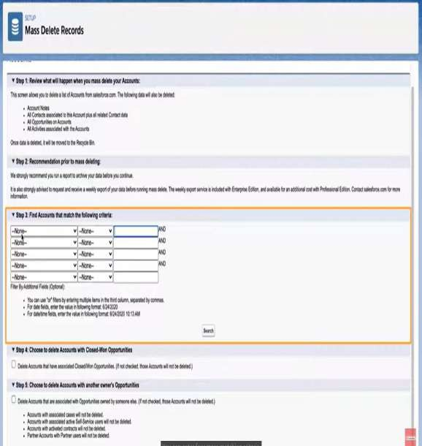
Mass Delete cont..
Login to Salesforce and then Setup
Go to Data Management and then Mass Delete Records
Choose the record type you wish to delete
4.
Specify conditions for selected items, such as
“State equals New York” or “City equals Toronto”
5. Click Search to find the matches based on your
criteria
6. Select the boxes next to item you wish to delete,
or optionally, the header box to select all items
7. Select Permanently Delete to permanently
remove these records
8. Click Delete

Slide 39




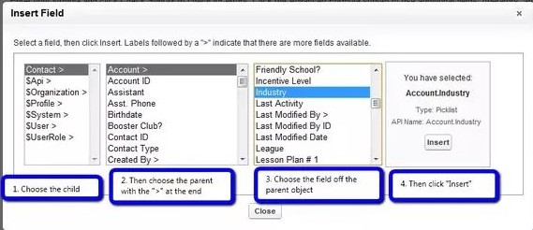
Introduction to Formula Fields
A formula field in salesforce helps you to combine values from 2 or more fields or expressions and display the resultant value.
Example
For example suppose you wanted to show concatenation of 2 field values or you want to calculate discount based on certain Field value then use formula fields.
A formula field is a read only field on page layout.
We can define formula field on both standard as well as custom objects.
It is a read only field, the value of formula filed evaluate from expression defined by us.
If we update any value in the expression, it automatically updates
formula field value.

Slide 40

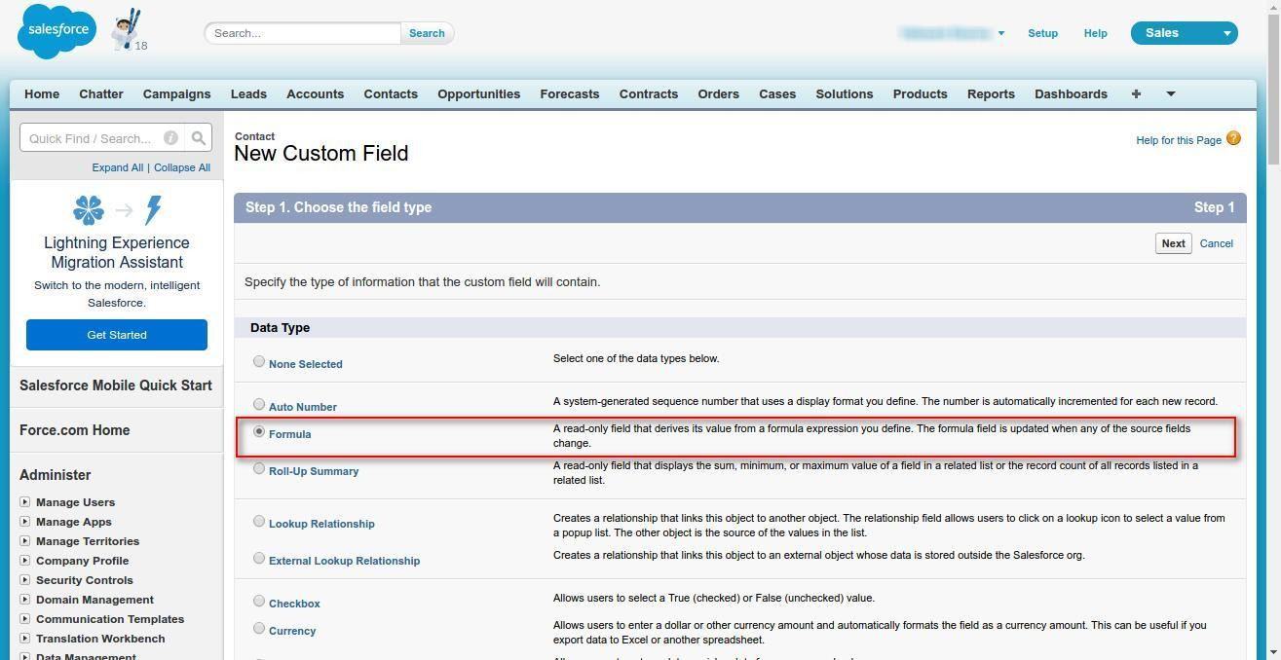


Steps to create a Formula field
Define the name of the formula field
Choose the output type of the formula field
Define the Formula using other fields combined with Operators or functions that salesforce Provides
Check syntax to verify if the formula is syntactically correct
Add the field to profiles & layout

Slide 41

Formula Return Types
The different datatypes a formula field can return are as follows. Meaning the formula will evaluate and return values of following data types.
We can return formula result in 7 ways those are:
Checkbox
Currency
Date
Date/Time
Number
Percent
Text
Checkbox
Currency
Date
Date/Time
Number
Percent
Text
Returns a Boolean value (true or false) value
Returns a number in currency format of up to 18 digits with a currency sign.
Returns data that represents a day on the calendar for example, by adding or subtracting days to other dates.
The current date
can be acquired by calling the
built-in function
TODAY() in a formula.
Returns data that represents a moment in time. A date/time field includes the date and also the time of day including hour, minutes, and seconds.
You can insert
the current date and time in a formula using the NOW() function
Returns a positive or negative integer or decimal of up to 18 digits
Returns a positive or negative integer or decimal of up to 18 digits
Returns a string of up to 3900 characters.

Slide 42






Operators in Formula Field
In formula fields you can use a number of operators to combine different fields namely
Addition/Subtraction/Division/Multiplication Exponentiation/Concatenate
Equal to/Not Equal to Case
Greater than/Less than/Greater than or Equal to/Less than or Equal to Logical And/Logical OR
If

Slide 43




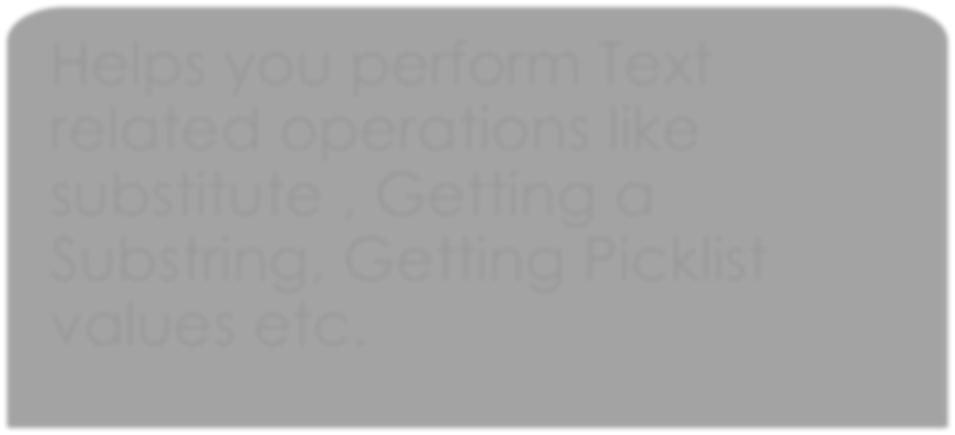




Function in Formula Field
Salesforce Provides a Number of Inbuilt Functions that you can use with Formula Fields.
Helps you to get Date and Time values that you can use in the Formula Condition
Helps you perform logical Operations like Checking for Blank values/If else conditions etc.
Helps you perform Math operations like getting absolute value/Logs etc.
Date and Time Functions
Logical Functions
Math Functions
Helps you perform Text related operations like substitute , Getting a Substring, Getting Picklist values etc.
Grouping related Operations. These available with summary, matrix, and joined reports.
Helps you Perform advanced Operations like VLOOKUP/Regex/ etc.
Text Functions
Summary Functions
Advanced Functions

Slide 44


Important Formula Field Functions
VLOOKUP
Returns a value by looking up a related value on a custom object similar to the VLOOKUP() Excel function.
REGEX
Compares a text field to a regular expression and returns TRUE if there is a match. Otherwise, it returns FALSE. A regular expression is a string used to describe a format of a string according to certain syntax rules.
ISPICKVAL
Determines if the value of a picklist field is equal to a text literal you specify.
IMAGE
Inserts an image with alternate text and height/width specifications.
ISNULL
Determines if an expression is null (blank) and returns TRUE if it is. If it contains a value, this function returns FALSE.
ISBLANK
Determines if an expression has a value and returns TRUE if it does not. If it contains a value, this function returns FALSE.
AND
Checks whether all arguments are true and returns TRUE if all arguments are true.
IF
Checks whether a condition is true, and returns one value if TRUE and another value if FALSE.
CASE
CASE(expression, value1, result1, value2, result2,...,else_result) Checks an expression against a series of values. If the expression compares equal to any value, the corresponding result is returned. If it is not equal to any of the values, the else-result is returned.
INCULDES
Determines if any value selected in a multi-select picklist field equals a text literal you specify.
MOD
Returns the remainder after a number is divided by a divisor.
TRIM
Removes all spaces from a text string except for single spaces between words

Slide 45

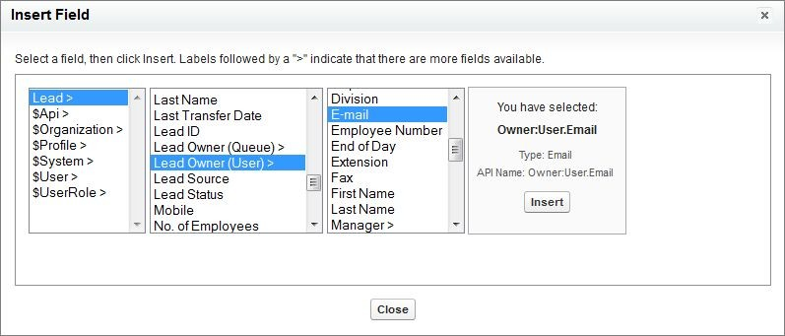

Cross Object Formula
The cross object formulas are defined on two related objects and reference merge fields on those objects.
Cross-object formulas are formulas that span two related objects and reference merge fields on those objects
Cross-object formulas can reference merge fields from a master (“parent”) object if an object is on the detail side of a master-detail relationship.
Cross-object formulas also work with lookup relationships.
You can reference fields from objects that are up to ten relationships away. Cross-object formulas are available anywhere formulas are used except when creating default values
You can reference fields from objects that are up to 10 relationships away.

Slide 46


Validation Rules – Intro.
Validation rules helps you to improve data quality by preventing users form entering incorrect data
It help you verify whether the data entered by user meets the Input requirements you have specified.
A validation rule can contain a formula or expression that evaluates the data in one or more fields and returns a value of “True” or “False.”
Validation rules help you to get clean and valid data from users.
Validation rule contain formula expression.
Validation rules also enables you to make fields mandatory based on the conditions you specify before the user can save the form
Validation rules run before the record is saved
We can display an error and corresponding error message on field or on the top of page.
Salesforce executes validation rules you defined and if data is valid then record will save.
If entered invalid data, it will display the associated error message without saving the record.
Even if the fields referenced in the validation rules are not visible on the page layouts, the validation rule still apply and will result in an error message if the rule fails.

Slide 47










Steps to Create Validation Rules
You can define Validation rules for all Standard and custom Objects
Account (Any Object).
Setup
Validation rule has 3 major parts
Here you define the name of the validation rule
Customize
Here you define a formula or expression that evaluates the data in one or more fields and returns a value of “True” or “False”.
Validation rules also include an error message to display to the user when the rule returns a value of “True” due to an invalid value.
Rule Name ₁ Error condition ₂
Error Message
3
To check the formula or expression for error click on Check Syntax.
In Error Message section define your message and position which will appear when user enter wrong data. You can specify where to display error message. Available options are "Top of the Page" or on the Field.
Finally, Save it.

Slide 48






Lightning Flow
Lightning Flow—the product that encompasses building, managing, and running flows and processes.
Flow Builder—a point-and-click tool for building flows.
Flow—an application that automates a business process by collecting data and doing
something in your Salesforce org or an external system.

Slide 49
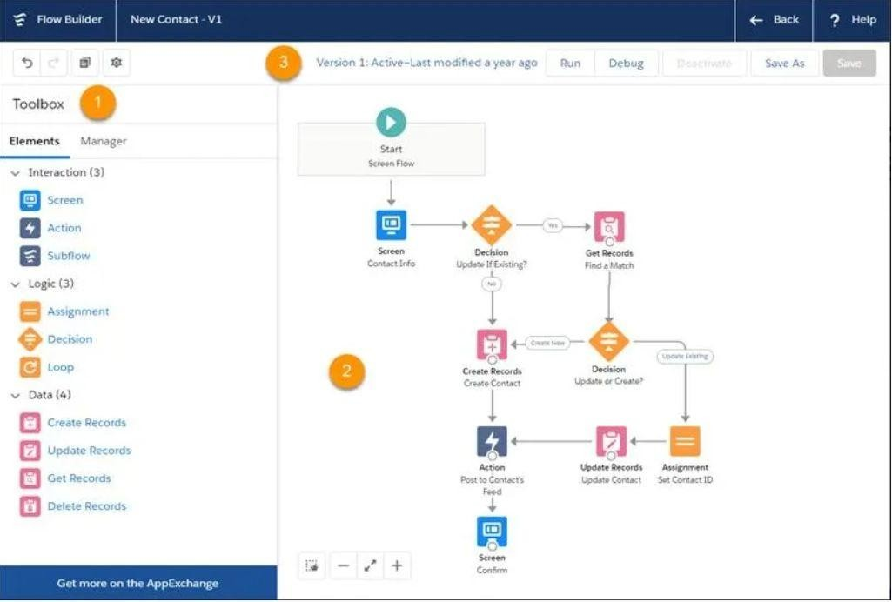
Elements of Flow

Slide 50
Toolbox (1) The toolbox contains the elements and resources you use to build your flow.
From the Elements tab, add new elements, like Screen and Create Records, to your flow.
From the Manager tab, create resources, such as variables, stages, and choices, to use in your flow. Or view a list
of all elements and resources that you’ve added to the flow.
Canvas (2) The canvas is the working area, where you build a flow by adding elements. As you add elements to the canvas and connect them together, you see a visual diagram of your flow. Button Bar (3) The button bar provides information about the flow, such as:
Whether the flow is active or not.
How long ago the flow was saved.
Whether the flow has any warnings or errors. To see warnings or errors, click the respective icon.
The button bar also includes two buttons for running a flow: Run and Debug.
Run runs the most recent saved version of the flow that you have open.
Debug lets you enter values for the flow’s input variables and display debug details while running the flow. That
way, you can verify how the flow processes data.

Slide 51

Flow resources
Each resource represents a value that you can reference throughout the flow.In Flow Builder, the Manager tab displays the resources that are available in the flow.
You can create some resources by clicking New Resource. Some resources, such as global constants and global variables, are provided by the system. Other resources are created when you add an element to a flow. For example, when you add a Decision element, a resource for each decision outcome is created.

Slide 52




Types Of Flow Available In Salesforce
Screen Flow:- Requires user interaction because it includes screens, local actions, steps, choices, or dynamic choices. Screen flows don’t support Pause elements.
Autolaunched Flow with No Flow Trigger:- Doesn’t require user interaction. This flow type doesn’t support screens, local actions, choices, or choice sets.
Autolaunched Flow with a Schedule Trigger:- Runs only from a schedule. This flow type doesn’t support user interaction, screens, local actions, choices, or choice sets.
Autolaunched Flow with a Record Trigger:- Makes before-save updates to the new or changed record that launches the flow. Only these elements are supported: Assignment, Decision, Get Records, and Loop.

Slide 53

How to build a flow?
From Setup, enter Flows in the Quick Find box, then select Flows, click New Flow, then select Screen Flow, click Next, and click Freeform.
Business scenario:- create a record quickly. Let’s build a flow to streamline account creation. When it runs, our flow collects user input about a new account, creates an account record, and lets the user upload files to the account record.
Add a Screen to Collect User Input
From the toolbox, drag a Screen element onto the canvas.
Name it New Account in the Label field.
In Screen Components, click Text and then click Text again.
Select the first Text screen component and enter Account Name in the Label field.
Select the second Text screen component and enter Phone Number in the Label field.
Select the footer and on the right and under Control Navigation, deselect Previous and Pause.
Click Done

Slide 54
Add a Create Records Element to Create Records
The Create Records element uses the values from New Account to create an account record.
From the Toolbox, drag a Create Records element onto the canvas. Name it Create
Account.
For How to Set the Record Fields, select Use separate resources, and literal values.
In Create a Record of This Object, in Object, select Account.
In Field, select Name.
In Value, select SCREEN COMPONENTS | Account_Name.
Click Add Field.
In Field, select Phone.
In Value, select SCREEN COMPONENTS | Phone_Number. Make sure that your
Create Records element looks like this.
Click Done

Slide 55

Create the Screen That Enables File Uploads
The second screen element lets users upload files for the account that they created.
Drag another Screen element onto the canvas.
In Screen Properties, configure these settings.
Name the screen Upload Files in the Label field.
Under Control Navigation, deselect Previous and Pause. If you don't make that selection users will be
able to navigate back to the first screen, and multiple accounts could accidentally be created.
On the left in Screen Components, click File Upload.
For API Name, enter accountFiles.
For File Upload Label, enter Upload Related Files.
For Related Record ID, select VARIABLES | AccountId from Create_Account. The resulting
value should be {!Create_Account}.
For Allow Multiple Files, select $GlobalConstant.True.
Click Done

Slide 56

Connect the Elements to Finish the Flow
Connecting the flow elements tells the flow what order to follow at run time.
Click the node at the bottom of Start and drag it to New Account.
Click the node at the bottom of New Account and drag it to Create Account.
Click the node at the bottom of Create Account and drag it to Upload Files.
Save the flow, name it Quick Account in Flow Label.
Click Save. Skip the warning you see about Lightning runtime. We talk about that next.

Slide 57

Activate Your Flow
Activate Your Flow
Only active flows are available in the Lightning App Builder, so first activate the flow.
From Setup, enter Flows in the Quick Find box, then select Flows.
Click Quick Account.
From the button bar in Flow Builder, click Activate.
Add Your Flow to the Home Page
Create a homepage.
From Setup, enter Builder in the Quick Find checkbox, and then select Lightning App Builder.
Click New.
Select Home Page and click Next.
Give the page a name and click Next.
Click CLONE SALESFORCE DEFAULT PAGE, select Home Page Default, and click Finish.
Drag the Flow component to the top of the right column.

Slide 58



For Flow, select Quick Account.
Save your changes and activate the page. Assign this page as the org
default home page and click Save.
To see your flow in action, go to your Home page.
Click Back to return to Setup.
Click , click View All, then click Home.

Slide 59
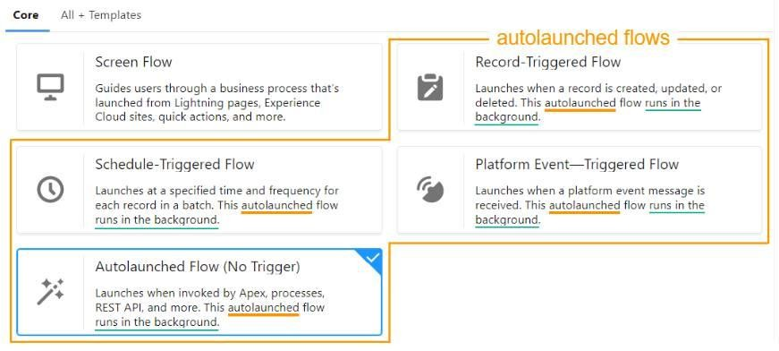
Autolaunched flows
Have you ever noticed that four of the flow types in the New Flow window are described as autolaunched? In fact, except for the screen flow, they’re all described as autolaunched and running in the background.

Slide 60
The Power of Autolaunched Flows
You may be wondering, “What’s so special about an Autolaunched flow?”
An Autolaunched flow has no trigger defined within the flow. It runs when it’s initiated by something else. You have much more control over when it runs because it’s not limited to a schedule, record change, or platform event.
It runs without any user interaction.
No other flow type is quite like it. A screen flow requires user interaction. The other three autolaunched flows run without any user
interaction, but they’re triggered only by a schedule, record change, or platform event. They can’t run subject to a user’s judgment or some Apex code.
•
Flow type | Runs without trigger | Runs without user interaction
Screen Flow | Yes | No
Record-Triggered | No | Yes
Schedule-Triggered | No | Yes
Platform Event-Triggered | No | Yes
Autolaunched | Yes | Yes

Slide 61
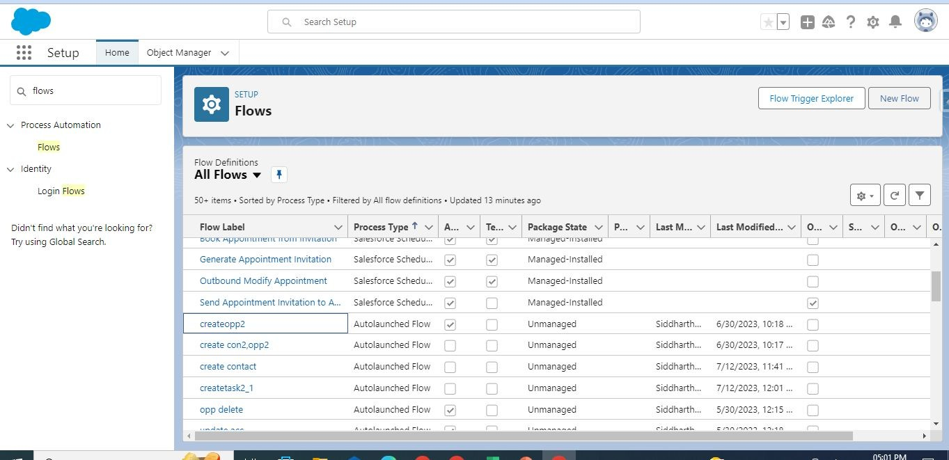
Steps to create Autolaunched flow
In this scenario we are going to create an Autolaunched flow to create an opportunity
Go to setup then search flows in the quick find, select flows

Slide 62
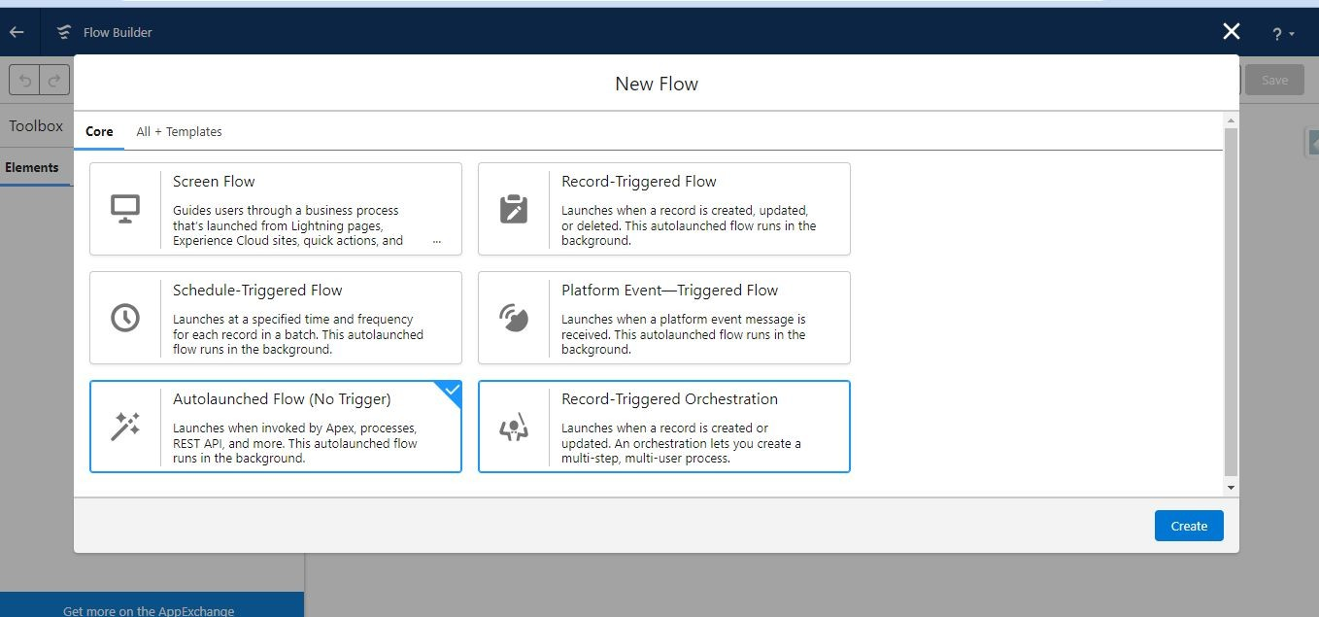
Creation of Autolaunched flow
Now click on new flow button and select Autolaunched flow(no trigger) and then click create

Slide 63
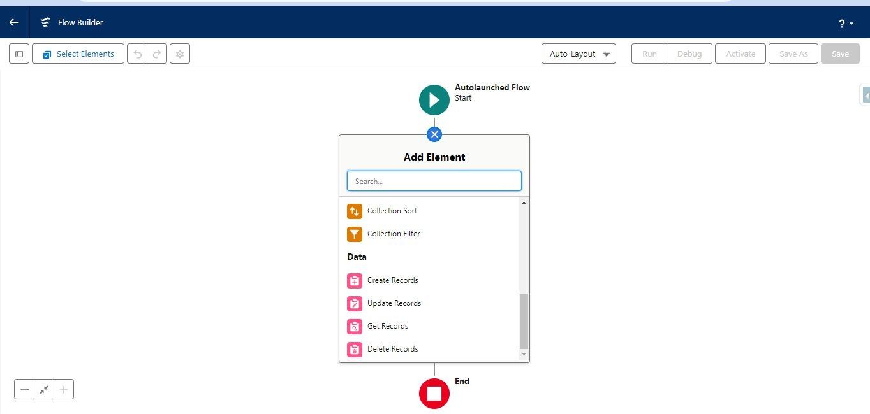
Creation of Autolaunched flow
Now click on ‘Add element’ and then click on ‘Create records’

Slide 64
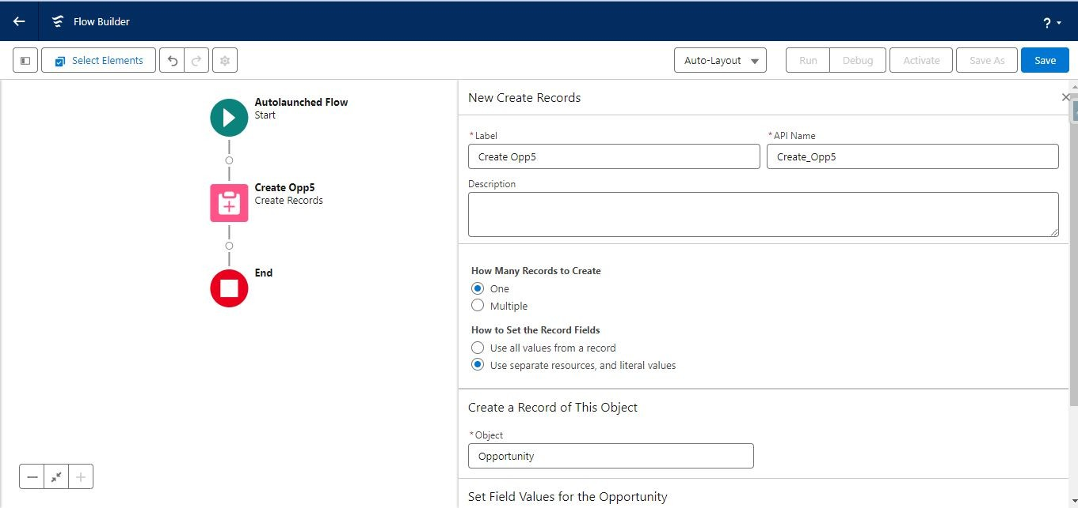
Creation of Autolaunched flow
Give name for ex: ‘create opp5’ and select ‘use separate resources and literal values’
Then select ‘opportunity’ object to create

Slide 65
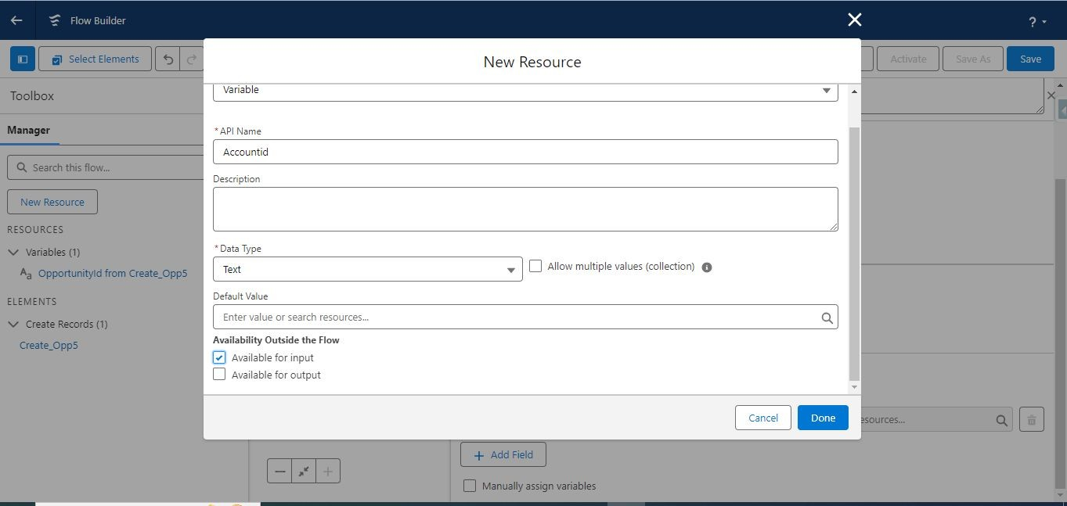
Creation of Autolaunched flow
Now create variable by clicking on new resources then give resource type ‘Variable’, give API Name, Data Type – ‘Text’ and Check ‘Available for input’

Slide 66
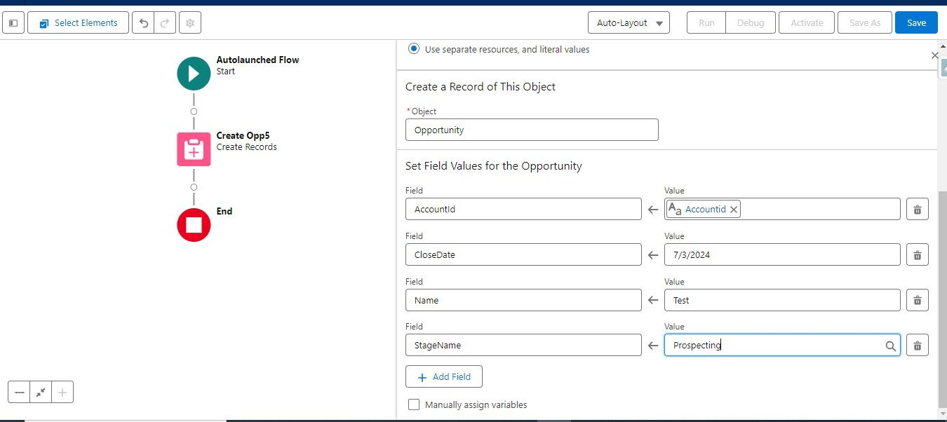
Creation of Autolaunched flow
Now give fields under ‘set field values for the opportunity as mentioned below and then save and activate it

Slide 67
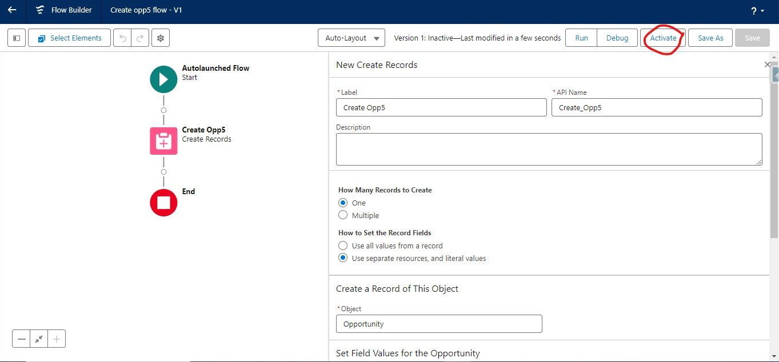
Creation of Autolaunched flow

Slide 68
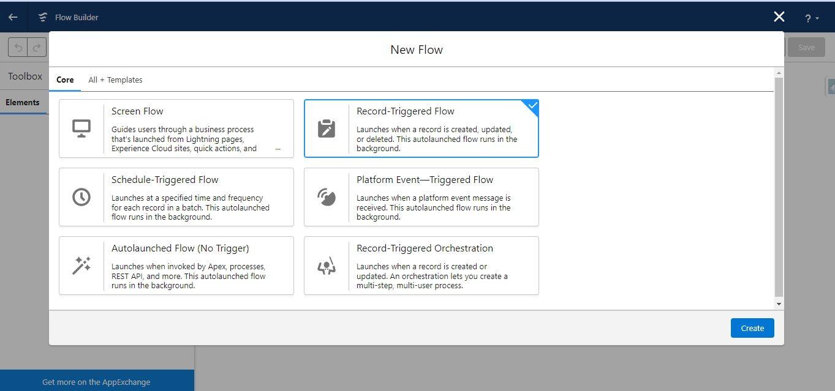
Creating Record triggered flow and calling auto launched flow
Launches when a record is created, updated, or deleted. This autolaunched flow runs in the background.
Click new flow and then select ‘Record- triggered flow’

Slide 69
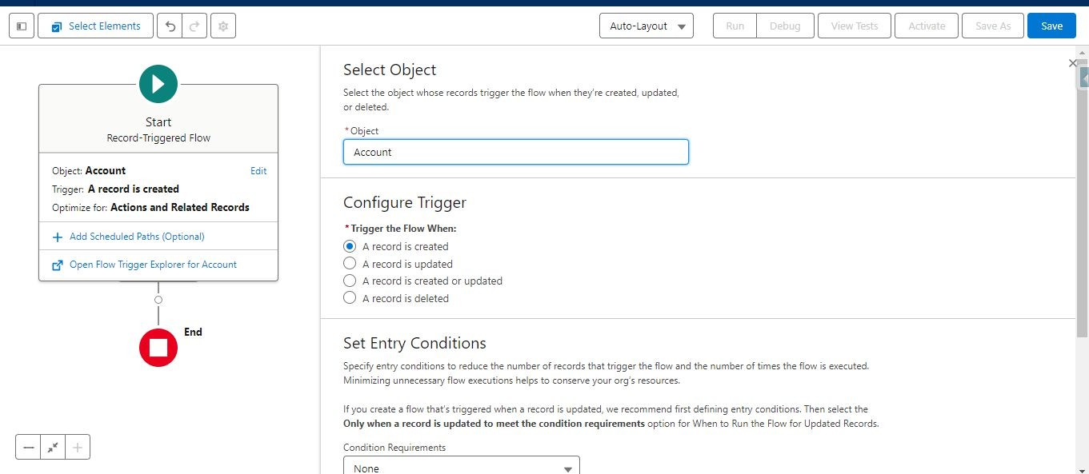
Creating Record triggered flow and calling auto launched flow
Here in this requirement we are creating the contact and opportunity based on account creation
So select object as ‘Account’

Slide 70
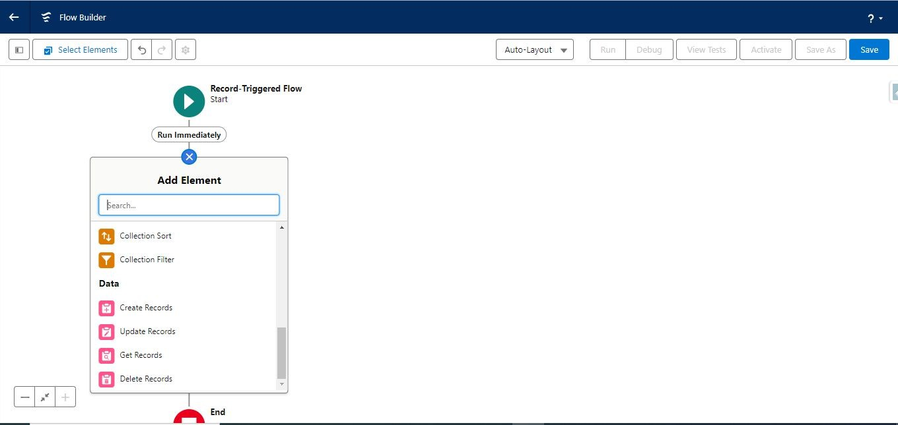
Creating Record triggered flow and calling auto launched flow
Now click ‘add element’ then click ‘create records’

Slide 71
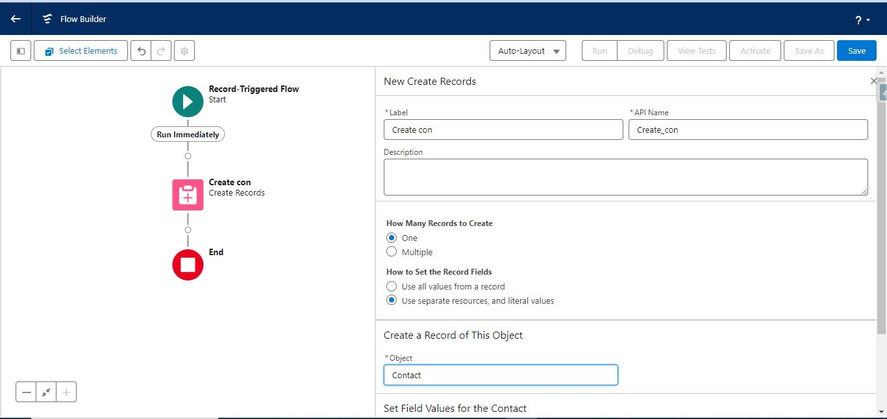
Creating Record triggered flow and calling auto launched flow
Give label ,apiname and then select ‘use separate resources and literal values’, select object ‘contact’

Slide 72
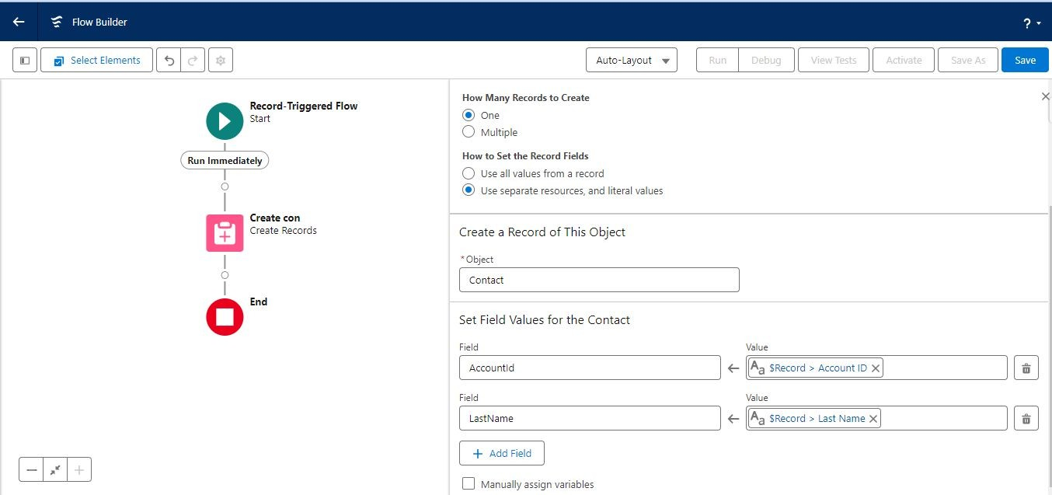
Creating Record triggered flow and calling auto launched flow
Now select the fields inside ‘Set field values for the contact’ as mentioned in below screenshot

Slide 73
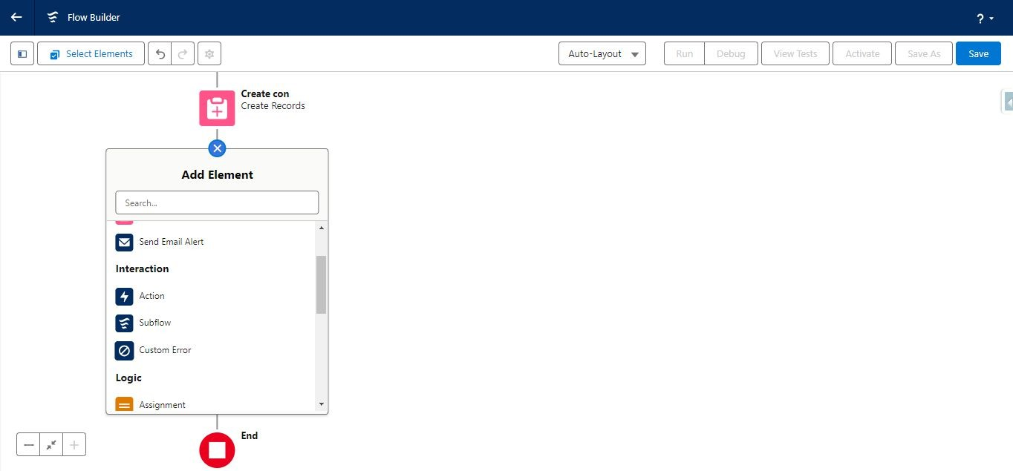
Creating Record triggered flow and calling auto launched flow
Now we are calling the subflow which we already created earlier in this current flow to create opportunity based on account creation. Follow below steps to achieve this.
Click add element and click on ‘Subflow’

Slide 74
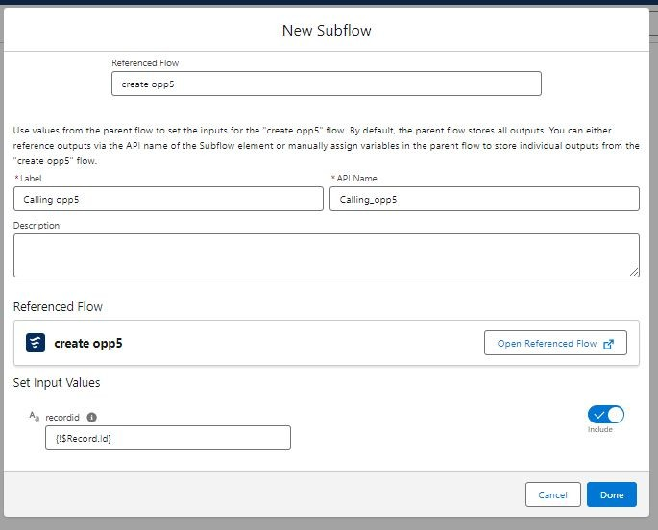
Creating Record triggered flow and calling auto launched flow
Give ‘reference flow’, ‘label’ and then ‘set input values’ as mentioned below

Slide 75
Testing Record triggered and Autolaunched flow
Now you can this entire process and then test it by creating account record then automatically contact and opportunity record should also be created

Slide 76
Schedule triggered flow
Schedule-triggered flows can run once, daily, or weekly, depending on how you configure them. They truly are automated automation! Use
schedule-triggered flows to handle regular tasks such as maintaining your org’s data or sending messages to your users. Here are a few examples of what scheduled flows can do for you.
use a schedule-triggered flow when you want the flow to:
Run at a specific time.
Run independent of a record change.
Run through many records at one time.
Run daily or weekly.

Slide 77
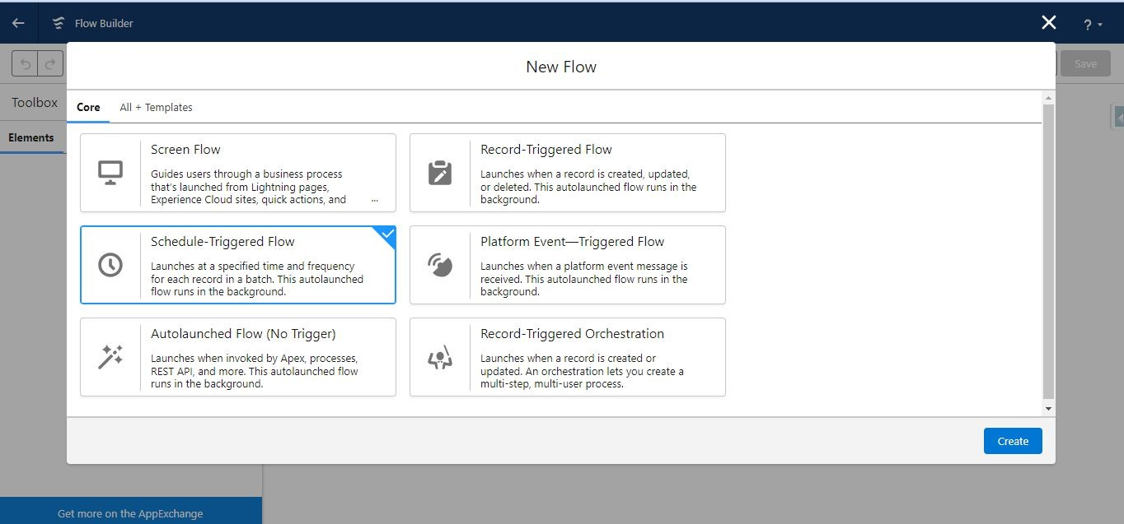
Creating Schedule triggered flow
Search ‘flows’ from the ‘quickfind’ and then click ‘new flow’
Now select ‘Schedule-Triggered Flow’ then ‘create’

Slide 78
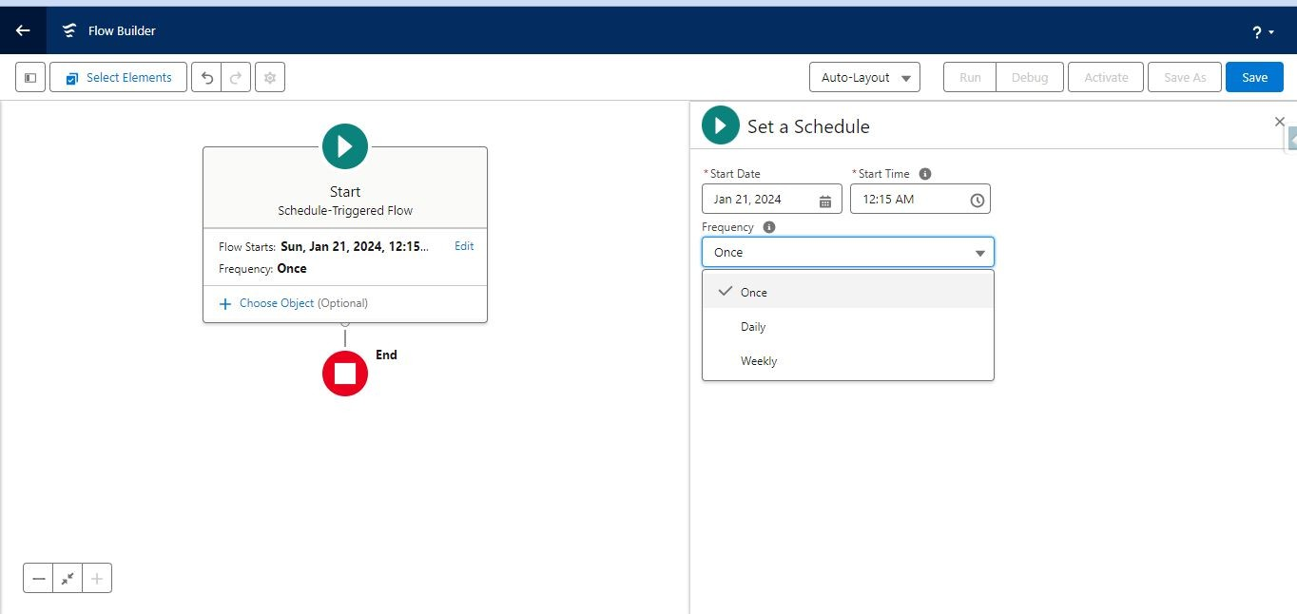
Creating Schedule triggered flow
Select ‘Start date’,’Start time’, ‘frequency’ according to the Schedule

Slide 79
Creating Schedule triggered flow
Now follow the same process as you follow for the above flows and according to requirement you create ‘Contact’ or ‘opportunity’
This flow will be scheduled to run at specific time because it is ‘Schedule – triggered flow’

Slide 80


Data Types & Collections
Chapter 13

Slide 81


What are we going to Cover in this Chapter
✔ Understanding Data types in apex
Primitive Data types-string, Decimal, DateTime, Integer, Boolean, Date Collection-List, Set, Map
✔ Conditional Apex- If, else
✔ Loops in Apex-For loop
✔ Best Practices in apex

Slide 82

Data Types
Apex is a strongly typed, object-oriented programming language just like any other programming language.
A data type in apex programming language is a set of data with values having predefined characteristics. Apex has variety of data types that you can use.
Data types in the apex tells about what type of data can be stored. All apex variables are initialized to null initially
The language usually specifies the range of data that can be stored for a given data type.
Different types of Data Types and field types. A compound data type that contains address field data. Polymorphic data type that returns string, picklist, reference, Boolean, currency, integer, double, percent, ID, date, datetime, url, or email data depending on the kind of field involved.
Types of Data type
Primitive (Integer, Double, Long, Date, Datetime, String, ID, or Boolean)
Collections (Lists, Sets and Maps)
sObject
Enums
Classes, Objects and Interfaces

Slide 83



Primitive Data Type…
Theses are the data types which is predefined by apex
A primitive data type can be string, integer, long decimal, Boolean, Double, Id, Date & DateTime.
All primitive data type passed by value, not by reference.
All apex variables, whether they are class member variables, are initialized as null.
Initialize variable to appropriate value before using them.
Boolean: A value that can only be assigned true ,false or null Ex- Boolean IsActive=false;
Date: A value that indicates a particular day Date Ex- Date myDate= Date.newIntance(2017,12,21);
String: It store all any set of characters surrounded by single quotes. For example String M=‘Salesforce Training’;
System. Debug(‘my institute name is ’+M);

Slide 84

Primitive Data Type
Integer, Long, Double and Decimal: To store numeric values in variables, declare variables with one of the numeric data types. Integer,Long Double and Decimal.
Integer: A 32 bit number that does not include a decimal point Integer has a minimum value of
-2,147,483,647 and maximum value 2,147,483,647 .
Example- Integer age =25; System. Debug(‘my age is ‘+ age);
Decimal: A number that includes a decimal point. Currency fields are automatically assigned the type Decimal.
Example : Decimal cy = 34.55
Long: This is a 64-bit number without a decimal point. This is used when we need a range of values wider than those provided by Integer.
Example Long num = 21474838973344648L; system. Debug(It is a very long number='+num);
DateTime: These are data types associated with dates and times along with date data type. The time data types store times. The DateTimes data types store both date and times.
Example- Time t= time.newInstance(19,20,20,7);
system.debug(t);
dateTime dt= datetime.newInstance(2014,1,31,7,8,16);
system.debug(dt);

Slide 85
Boolean
A value that can only be assigned true, false, or null. For example: Boolean is Winner = true,
Date
A value that indicates a particular day. Unlike Datetime values, Date values contain no information about time. Date values must always be created with a system static method.
Datetime
A value that indicates a particular day and time, such as a timestamp. Datetime values must always be created with a system static method
Decimal
A number that includes a decimal point. Decimal is an arbitrary precision number. Currency fields are automatically assigned the type Decimal.
Double
ID
A 64-bit number that includes a decimal point. Doubles have a minimum value of -283 and a maximum value of 263-1. For example: Double d=3.14159,
Any valid 18-character Force.com record identifier. For example: ID = ‘100300000003T2PGAAO’;
Integer
A 32-bit number that does not include a decimal point. Integers have a minimum value of -2,147,483,648 and a maximum value of 2,147,483,647. For example:
Integer i = 1;
Long
A 64-bit number that does not include a decimal point. Longs have a minimum value of -263 and a maximum value of 263-1. Use this data type when you need a range of values wider than those provided by Integer. For example:
Long 1 = 2147483648L:
String
Any set of characters surrounded by single quotes. For example, String s = The quick brown fox jumped over the lazy dog.';
Time
A value that indicates a particular time. Time values must always be created with a system static method.

Slide 86



Data Types- SObject…
SObjects (short for “Salesforce Objects”) are standard or custom objects that stores record data in the Force.com database. There is also an SObject data type in Apex that is the Programmatic representation of these SObjects and their data in code.
This is a special data type in Apex. We can refer this as any data type which is supported in Apex. sObject is a generic data type for representing an Object that exists in Force.com. It could be Standard object ,Custom object or a Apex class.
An Sobject, can be a generic SObject or be a specific SObjects, such as an Account, Contact, or MYcustom c.
Developers refer to SObjects and their fields by their API names.
So you can consider SObject as class for which you can create an instance. In database terminology Object/sObject is a Table and the fields on the objects are the Columns of that table.
Account acc= new Account (Name = 'Training');
system.Debug('Account record name is ' + acc);

Slide 87



Conditions In Apex
A conditional statement is a conditional based code like java which control the flow of execution of the program. This execution order depends on the supplied data values and the conditional logic
The control statement are
Selection Statements Repetition Statements Selection Statements 1.If
Else
If else
Repetition Statements
For loop
While loop

Slide 88
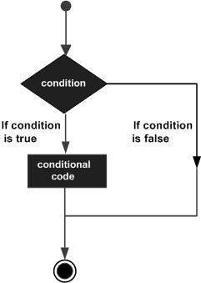
Selection Statements In Apex
If: The if statement is apex conditional branch statement. It can be used to route program execution through two different paths. Here is the general form of the if statement:
Example
if (condition) statement1; else statement2;
Integer i=1, j=5; integer A,B,C; If (i>0){
A=10;
}
If(j<2){ B=20;
}
Else{ C=15;
}
System.Debug(A); System.debug(B); System.debug(c);
Condition
Conditional code

Slide 89
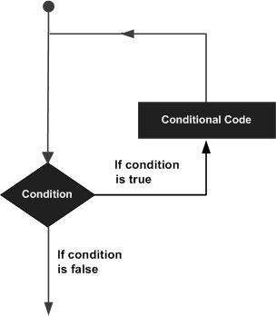
Repetition (Loop)…
Loops are a piece of code that let you repeatedly execute code.
Apex supports the standard traditional for loop as well as other advanced types of Loops. In this chapter, we will discuss in detail about the Loops in Apex.
Example
for(type itr-var : collection) statement-block
Here, type specifies the type and itr-var specifies the name of an iteration variable that will receive the elements from a collection, one at a time, from beginning to end. The collection being cycled through is specified by collection.
Integer[] numbers= new Integer[]{1, 2, 3, 4, 5,6,7};
for (Integer i : numbers) {
System.debug(i);
}
List<Account> accs = [select name from account];
for(account ac:accs) {
System.debug('account name are ' + ac.name);
}
Conditional code
Condition

Slide 90
Repetition (Loop)
For – loop: Here is the general form of the traditional for statement:
for(initialization; condition; iteration) {
// body
}
List<Account> accs = [SELECT Id, Name FROM Account ];
for(Account a : accs){
System.debug('Account is '+a.name);
}
While Loops
The Apex while loop repeatedly executes a block of code as long as a particular Boolean condition remains true.
syntax
while (condition) {
//code_block
}
Integer count = 1; while (count < 11) { System.debug(count); count++;
}

Slide 91





Data Type- Collections
Collections - Collections is a type of variable that can store multiple number of records Apex has 3 types of collections. Lists, Sets and Maps.
A list is like an array, a sequential collection of elements with first index position as zero. List can contain elements of primitive types, sObjects, user-defined objects, Apex objects or even other collections. A list can contain up to four levels of nested collections. List can contain duplicate elements.
A set is also a collection of elements and elements can be of any data type. Unlike list, set contains unique elements and elements in set are not in any specific order.
A map is a collection of key-value pairs. Keys and values can be any data type. Keys are unique and map elements must be accessed by the key as the order of map elements are not reliable.

Slide 92
List
A List is a collection of any data type- primitive type, Sobject, collections
List is an ordered collection of element that is differentiate by their indices. A list is a collection of elements, such as Integers, Strings, objects, or other collections.
It can increase or decrease its size in run time.
Duplicate value allowed.
Insertion order is preserved.
The first index position in a list is always zero.
Null value are accepted.

Slide 93
List<String> stList = new List<String>();
stList.add(‘ABC’);
stList.add(‘DEF’);
stList.add(‘FGH’);
OR
List<String> stList = new List<String>{‘ABC’,’DEF’,’FGH’};

Slide 94
List Method
There are methods available for Lists which we can be utilized while programming to achieve some functionalities like calculating the size of List, adding an element, etc.
Following are some most frequently used methods −
size():Returns the number of elements in the list.
isEmpty():Returns true if the list has zero elements.
size():Returns the number of elements in the list.
sort():Sorts the items in the list in ascending order.
add(listElement):Adds an element to the end of the list.
addAll(fromList):Adds all of the elements in the specified list to the list that calls the method. Both lists must be of the same type.
clear():Removes all elements from a list, consequently setting the list's length to zero.
clone():Makes a duplicate copy of a list.
remove(index):Removes the list element stored at the specified index, returning the element that was removed.
get(index):Returns the list element stored at the specified index.
addAll(fromSet):Add all of the elements in specified set to the list that calls the method. The set and the list must be of the same type.
equals(list2):Compares this list with the specified list and returns true if both lists are equal; otherwise, returns false.

Slide 95
add(element)
It adds an element into the list. it always adds at the last.
List<String> l = new List<String>();
l.add(‘abc');
System.debug(l); // (‘abc')
size() Returns the number of elements in the list.
l.add(‘def');
System.debug(l.size()); // 2
System.debug(l); // (‘abc','def')
get(index) Returns the element on the ith index.
System.debug(l.get(0)); // ‘abc'
remove(index) Removes the element on ith index.
l.remove(1);
System.debug(l); // (‘abc')
clone() Makes a duplicate of a list.
List<String> l2 = l.clone();

Slide 96
set() Sets the element on the ith position of the list. If there is already a value
then value gets overridden.
l.add(‘def');
l.add(‘ghi');
System.debug(l);//(‘abc','def','ghi')
l.set(2,'aaa');
System.debug(l);//(‘abc','def','aaa')
sort() Sorts the item in ascending order
but works with primitive datatypes only.
l.sort();
System.debug(l);//('aaa',‘abc','def')
isEmpty() Returns true if the list is empty.
System.debug(l.isEmpty()); // false
clear() Clears the list.
l.clear()

Slide 97

Set
A set is a collection of unique unordered multiple numbers of records. It can contain primitive data types, such as String, Integer. It can also contain more complex data types, such as sObjects.
A set is unordered collection of element where elements can be of any type-primitive ,sobject.
Set do not allow duplicates values.
It grow dynamically in run time.
Insertion order is not preserved.
List<Integer> ls = new List<Integer>(); ls.add(1);
ls.add(2);
// Create a set based on a list Set<Integer> s1 = new Set<Integer>(ls);
// Elements are copied from the list to this set System.debug(s1);
// DEBUG|{1, 2};

Slide 98

Set Methods
The following are methods for Set. All are instance methods.
contains(setElement):Returns true if the set contains the specified element.
containsAll(listToCompare):Returns true if the set contains all of the elements in the specified list. The list must be of the same type as the set that calls the method.
containsAll(setToCompare):Returns true if the set contains all of the elements in the specified set. The specified set must be of the same type as the original set that calls the method.
equals(set2):Compares this set with the specified set and returns true if both sets are equal; otherwise, returns false.
isEmpty():Returns true if the set has zero elements.
remove(setElement):Removes the specified element from the set if it is present.
removeAll(listOfElementsToRemove):Removes the elements in the specified list from the set if they are present.
retainAll(listOfElementsToRetain):Retains only the elements in this set that are contained in the specified list.
size():Returns the number of elements in the set (its cardinality).
add(setElement):Adds an element to the set if it is not already present.
addAll(fromList):Adds all of the elements in the specified list to the set if they are not already present.
addAll(fromSet):Adds all of the elements in the specified set to the set that calls the method if they are not already present.
clear():Removes all of the elements from the set.

Slide 99
add(element) Adds an element to set
Set<String> s = new Set<String>();
s.add(‘abc');
s.add(‘ABC');
s.add(‘abc');
System.debug(s);//(‘abc','ABC')
addAll(list/set) Adds all of the elements in the specified list/set to the set if they are not already present.
List<String> l = new List<String>();
l.add(‘abc');
l.add(‘def');
s.addAll(l);
System.debug(s);//(‘abc','ABC','def')
clear() Removes all the elements.
s.clear();
s.addAll(l);
clone() Makes duplicate of a set.
List<String> s2 = s.clone();
System.debug(s);//(‘abc','def')

Slide 100
contains(elm) Returns true if the set contains the specified element.
Boolean result = s.contains('abc');
System.debug(result); // true
containsAll(list) Returns true if the set contains all of the elements in the specified list. The list must be of the same type as the set that calls the method.
Boolean result = s.containsAll(l);
System.debug(result); // true
size() Returns the size of set.
System.debug(s.size()); // 2
retainAll(list) Retains only the elements in this set that are contained in the specified list and removes all other elements.
s.add(‘ghi');
System.debug(s);//(‘abc','def','ghi')
s.retainAll(l);
System.debug(s);//(‘abc','def')
remove(elm) Removes the specified element from the set if it is present.
s.add(‘ghi');
s.remove(‘ghi');
System.debug(s);//(‘abc','def')
removeAll(list) Removes the elements in the specified list from the set if they are present.
s.add(‘ghi');
s.removeAll(l);
System.debug(s);//(‘ghi')

Slide 101


Map
A map is a collection of key value pair which contains the unique key for each value. Keys and values can be any data type—primitive types, collections, sObjects, user-defined types, and built-in Apex types.
Map can have duplicate values in a map
Key is unique in map.
To declare a map, use the Map keyword followed by the data types of the key and the value within <> characters.
Map<String, String> colorCodes = new Map<String, String>();
colorCodes.put('Red','FF0000'); colorCodes.put('Blue', '0000A0');
Boolean contains = colorCodes.containsKey('Blue'); System.assertEquals(true, contains);

Slide 102

Map Methods
The following are methods for Map. All are instance methods.
clear():Removes all of the key-value mappings from the map.
clone():Makes a duplicate copy of the map.
containsKey(key):Returns true if the map contains a mapping for the specified key.
deepClone():Makes a duplicate copy of a map, including sObject records if this is a map with sObject record values.
equals(map2):Compares this map with the specified map and returns true if both maps are equal; otherwise, returns false.
get(key):Returns the value to which the specified key is mapped, or null if the map contains no value for this key.
getSObjectType():Returns the token of the sObject type that makes up the map values.
isEmpty():Returns true if the map has zero key-value pairs.
keySet():Returns a set that contains all of the keys in the map.
put(key, value):Associates the specified value with the specified key in the map.
putAll(fromMap):Copies all of the mappings from the specified map to the original map.
putAll(sobjectArray):Adds the list of sObject records to a map declared as Map<ID, sObject> or Map<String, sObject>.
remove(key):Removes the mapping for the specified key from the map, if present, and returns the corresponding value.
size():Returns the number of key-value pairs in the map.
values():Returns a list that contains all the values in the map.

Slide 103
put(key,value)Associates the specified value with the specified key in the map.
Map<Integer,String> m = new Map<Integer,String>();
m.put(1, 'Bhavna');
m.put(2, 'Sapna');
System.debug(s);//(1=‘Bhavna',2='Sapna')
putAll(map) Copies all of the mappings from the specified map to the original map.
Map<Integer,String> n = new Map<Integer,String>();
n.put(3, 'Bhavya');
n.put(4, 'Divya');
m.putAll(n);
System.debug(m);// (1=‘Bhavna',2='Sapna'3='Bhavya',4='Divya')
get(key) Returns the value to which the specified key is mapped, or null if the map contains no value for this key.
System.debug(m.get(1)); // ‘Bhavna'
System.debug(m.get(2)); // 'Sapna'
System.debug(m.get(3)); // 'Bhavya'
System.debug(m.get(4)); // 'Divya'

Slide 104
values() Returns a list that contains all the values in the map.
List<String> l = new List<String>();
l = m.values();
System.debug(l);// (‘Bhavna','Sapna','Bhavya','Divya')
clone() Makes a duplicate copy of the map.
Map<Integer,String> o = new Map<Integer,String>();
o = m.clone();
System.debug(o);// (1=‘Bhavna',2='Sapna'3='Bhavya',4='Divya')
keySet() Returns a set that contains all of the keys in the map.
System.debug(m.keySet());// (1,2,3,4)
containsKey(key)Returns true if the map contains a mapping for the specified key.
Boolean result1 = m.containsKey(3);
System.debug(result1); // true
Boolean result2 = m.containsKey(6);
System.debug(result2); // false

Slide 105
isEmpty() Returns true if map has 0 key.
Boolean result = m.isEmpty();
System.debug(result); // false
size() Returns the number of keyvalue pairs in the map.
System.debug(m.size()); // 4
remove(key)Removes the mapping for the specified key from the map, if present, and returns the corresponding value.
m.remove(4);
System.debug(m);//(1=‘Bhavna',2='Sapna'3='Bhavya')
clear() Removes all of the key-value mappings from the map.
m.clear();

Slide 106
SOQL, SOSL, DML and Exception Handling

Slide 107


Salesforce Object Query Language (SOQL)
&
Salesforce Object Search Language (SOSL)

Slide 108

Learning Objectives for this Session
✔ Introduction to SOQL in apex
✔ Clause in SOQL
✔ Relationship in SOQL
Parent to child
Child to parent
✔ Introduction to SOSL
✔ Use of SOSL
✔ Where to use SOSL
✔ SOSL in apex use of SOQL
✔ Difference between SOSL & SOQL

Slide 109


Salesforce Object Query Language(SOQL)
Salesforce Object Query Language (SOQL) to search Salesforce data for specific information.
SOQL is similar to the SELECT statement in the widely used Structured Query Language (SQL) but is designed specifically for Salesforce data.
Syntax
SELECT fields FROM ObjectName List<account>acc=[select name from account]; system.Debug('name'+acc);
When to Use SOQL
Use SOQL when you know which objects the data resides in, and you want to retrieve data from a single object or from multiple objects that are related to one another.
Count the number of records that meet specified criteria.
Sort results as part of the query.
You want results returned immediately for manipulation within a block of Apex code.
You know that the query will return a small amount of data.

Slide 110
Clause in SOQL
Where:
List<account>acc=[select name from account Where name='Training Institute’];
Limit :
List<account>acc =[select name from Account limit 5];
Offset :
List<account>acc= [select name from Account offset 5];
Order By :
List<account>acc =[select id, name from account Order By Name asc];
In :
List<account>acc =[select Name, industry from account where industry IN('education','energy')];
Like :
List<account>acc=[select Name from account where name like '%corp%'];
And :
list<opportunity>acc= [SELECT name, Amount FROM opportunity WHERE Amount > 1000 AND Amount < 10000];
Or :
list<opportunity>oppty = [SELECT name, Amount FROM opportunity WHERE name = 'expresslogistics' OR name = 'GenePoint SLA'];

Slide 111
Ascending :
List<account>acc =[select id, name from account Order By Name asc];
Descending :
List<account>acc =[select id, name from account Order By Name desc ];
GROUP BY :
list<aggregateresult> leads=[SELECT LeadSource, COUNT(Name) FROM Lead GROUP BY LeadSource];
ORDER BY :
list<account>acc=[SELECT Name FROM Account ORDER BY Name DESC NULLS LAST];
Having:
list<aggregateresult> lead2=[SELECT LeadSource, COUNT(Name) FROM Lead GROUP BY LeadSource HAVING COUNT (Name) > 100];
FOR UPDATE:
Account [] accts = [SELECT Id FROM Account LIMIT 2 FOR UPDATE];
View :
list<contact>con = [SELECT Name, ID FROM Contact LIMIT 1 FOR VIEW];

Slide 112
Relationship queries: child-to-parent
Select Contact.FirstName, Contact.Account.Name FROM Contact
SELECT Id, Name, Account.Name FROM Contact WHERE Account.Industry = 'Media'
Relationship queries: parent-to-child
Select Name, (SELECT LastName FROM Contacts) FROM Account
SELECT Account.Name, (SELECT Contact.LastName FROM Account.Contacts) FROM Account

Slide 113

Relationship Query Limitations
When you design SOQL relationship queries, there are several limitations to consider.
Relationship queries are not the same as SQL joins. You must have a relationship between objects to create a join in SOQL.
No more than 35 child-to-parent relationships can be specified in a query. A custom object allows up to 25 relationships, so you can reference all the child-to-parent relationships for a custom object in one query.
No more than 20 parent-to-child relationships can be specified in a query.
In each specified relationship, no more than five levels can be specified in a child-to-parent relationship. For example, Contact.Account.Owner.FirstName (three levels).
In each specified relationship, only one level of parent-to-child relationship can be specified in a query. For example, if the FROM clause specifies Account, the SELECT clause can specify only the Contact or other objects at that level. It could not specify a child object of Contact.

Slide 114

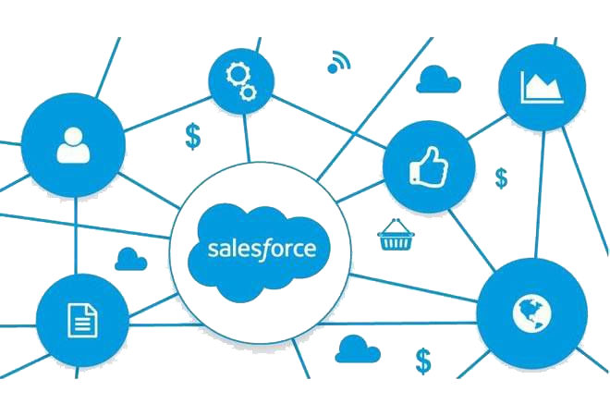
Salesforce Object Search Language(SOSL)
Salesforce Object Search Language (SOSL) is a Salesforce search language that is used to perform text searches in records. Use SOSL to search fields across multiple standard and custom object records in Salesforce.
SOSL is a search language in salesforce and the important feature is that Unlike SOQL.
In SOQL, we can query only one object at a time but in SOSL, We can search for some specified string like ‘Training Institute’ in multiple objects at the same time.
You can search text, email, and phone fields for multiple objects.
The SOSL query start with the keyword ‘FIND’.
The result of SOSL is a list of lists of sObjects “List<List<sObject>>”.
Syntax
List<List<Sobject>> searchlist=[Find 'Text*' IN ALL FIELDS RETURNING Account, Contact ];
System.Debug(Searchlist);
find {test}
Find {Upsert} RETURNING Account(Name,Phone), Contact(LastName)

Slide 115
When To Use SOSL
Use SOSL when you don’t know which object or field the data resides in, and you want to:
Retrieve data for a specific term that you know exists within a field. Because SOSL can tokenize multiple terms within a field and build a search index from this, SOSL searches are faster and can return more relevant results.
Retrieve multiple objects and fields efficiently where the objects might or might not be related to one another.
01
02
Retrieve data for a particular division in an organization using the divisions feature.
Retrieve data that’s in Chinese, Japanese, Korean, or Thai. Morphological tokenization for CJKT terms helps ensure accurate results
03
04

Slide 116
Where Can Use SOSL
SOSL is used if we don’t know in which object the data is present.
We can search only on those fields whose data type is text, phone and Email.
We cannot perform DML operation on search result.
1
We can retrieve multiple objects and field values efficiently when the objects may or may not be related to each other.
We can use in classes but not in Triggers.
2
3
4
5

Slide 117










Performance Considerations
If your searches are too general, they are slow and return too many results. Use the following clauses to define efficient text searches.
IN
LIMIT
OFFSET
RETURNING
WITH DATA CATEGORY
WITH
DivisionFilter
WITH NETWORK
WITH
PricebookId
8
Specifies the price book ID to return.
1
Limits the types of fields to search, including email, name, or phone.
2
Specifies the maximum number of rows to return.
3
Displays the search results on multiple pages.
4
Limits the objects and fields to return.
5
Specifies the data categories to return.
6
Specifies the division field to return.
7
Specifies the community ID to return.

Slide 118

SOSL Limits
The search engine limits the number of records analyzed at each stage of the search process. Sometimes, these limits cause a matching record to be excluded from a user’s results.
This image illustrates how the search engine processes SOSL searches and limits results. Each color represents an object, and each raindrop represents some records. The numbers correspond to this flow:
The search engine looks for matches to the search term across a maximum of 2,000 records (this limit starts with API version 28.0)
SOSL applies different limits for a given object or situation. If the search is for a single object, the full record limit is applied. If the search is global across multiple objects, each object has individual limits that total 2,000 records.
Admins (users with the View All Data permission) see the full set of results returned.
For all other users, SOSL applies user permission filters. Individual users see only those records that they have access to. Results sets and order vary by the user issuing the search and can change throughout the day as records are added or removed from the index.

Slide 119
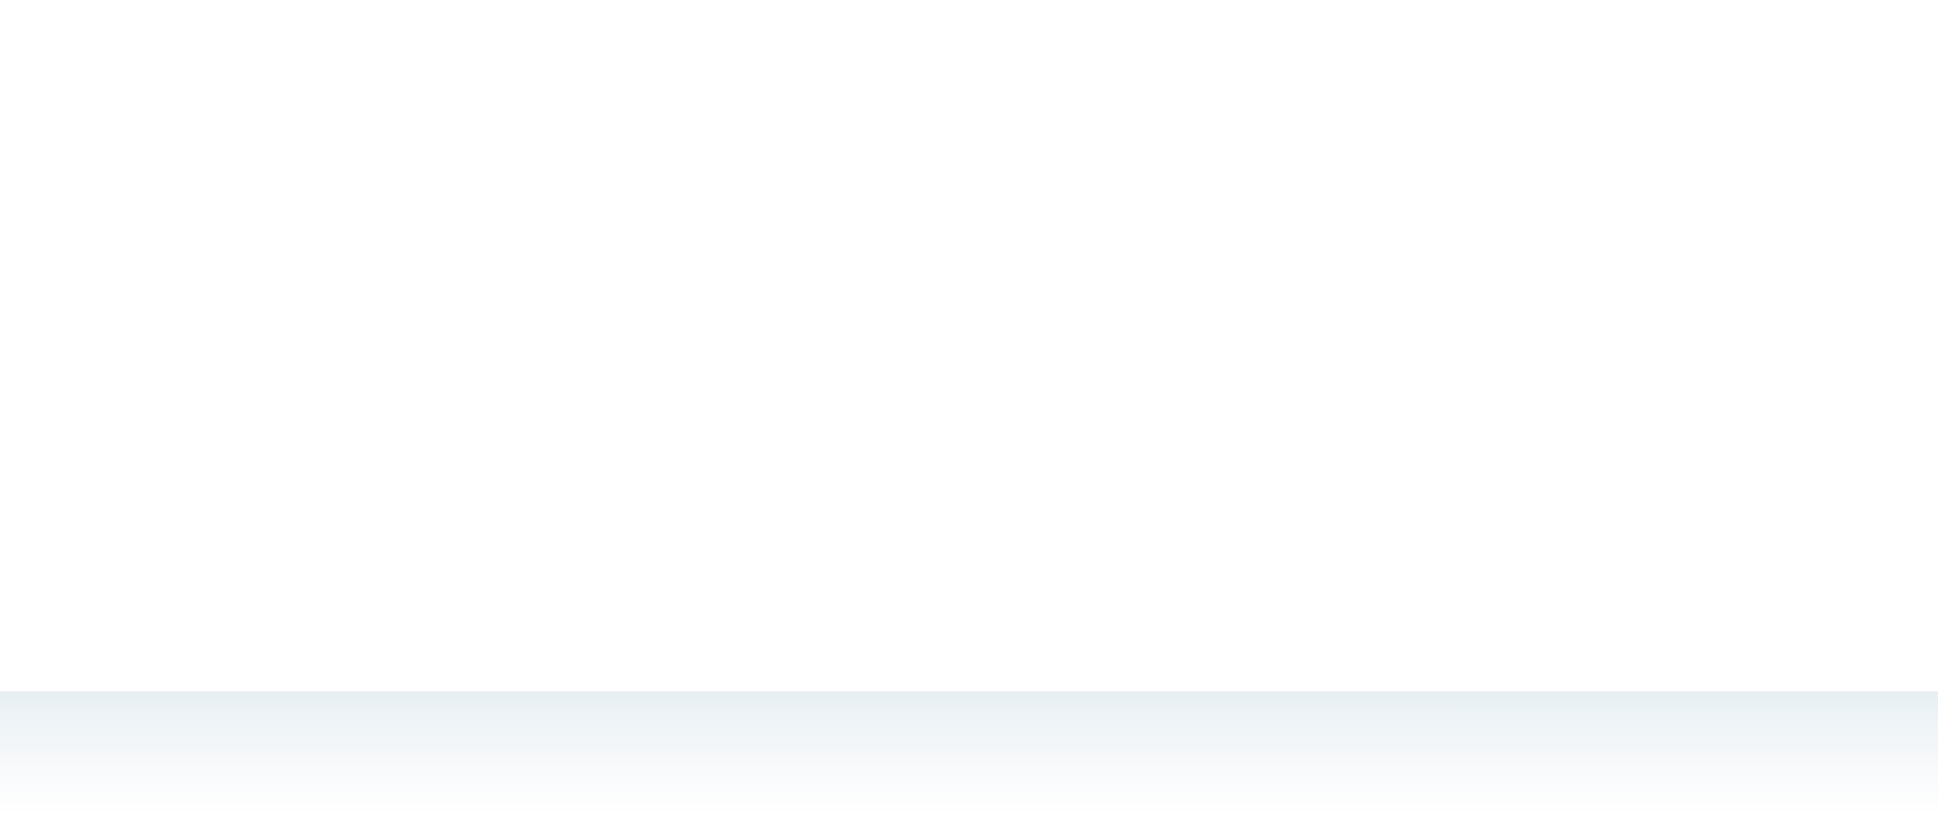






SOSL Queries
SOSL is salesforce object search language
SOSL statements evaluate to a list of lists of SObjects where each list contains the search results for a particular sobject type
SOSL queries are only supported in Apex classes and anonymous blocks.
We cannot use a SOSL query in a trigger

Slide 120
Difference between SOQL and SOSL
SOQL SOSL
Only one object at a time can be searched(Search in Single • object)
Many object can be searched at a time(Search in entire organization or Database)
Query all type of field • Query on only email, text or phone
It can be used in classes n triggers • It can use in classes but not in trigger
DML Operation can be performed on query results • DML Operation cannot be performed on search results
Return Records • Return Records

Slide 121



Data Manipulation Language(DML)
Apex Data Manipulation Language (DML) operations allow you to modify records one at a time, or more efficiently in batches of multiple records.
DML enables you to insert, update, delete or restore data in the database.It has five major DML operation types are listed
Followings are DML action
Insert : Use this statement to create the records of sObject.
Update : Use this statement to update the existing records of sObject.
Upsert: Use this statement to create the new record or update the existing records on the basis of Id or external field.
Delete : Use this statement to delete the existing record
Undelete : Use this statement to restore the records from Organization recycle bin.

Slide 122



Insert Operation
Insert operation is used to create new records in Database. You can create records of any Standard or Custom object using the Insert DML statement.
The Insert statement adds up to 200 records of a single object type to the database. When all records succeed, they contain their new unique identifiers.
If any record fails, a DmlException is raised and the database is returned to its state prior to the Insert statement.
Account acc = new Account(name = 'Training Institute');
insert acc;

Slide 123
Update Operation
The update DML operation modifies one or more existing sObject records, such as individual accounts or contacts invoice statements, in your organization’s data.
Update saves up to 200 existing records of a single object type. Existing records are identified.
Syntax
update sObject update sObject[]
Example
Account a = new Account(Name='Training institute' );
insert a;
Account myAcct = [SELECT Id, Name, BillingCity FROM Account WHERE Id = :a.Id];
myAcct.BillingCity = 'San Francisco';
update myAcct;

Slide 124

Upsert Operation
The upsert DML operation creates new records and updates sObject records within a single statement, using a specified field to determine the presence of existing objects, or the ID field if no field is specified.
Upsert combines the behavior of the Insert and Update operations on up to 200 records of the same object type.
First, it attempts to locate a matching record using its unique identifier or external identifier. If one is found, the statement acts as an Update. If not, it behaves as an Insert.
How Upsert Chooses to Insert or Update
Upsert uses the sObject record's primary key (the ID), an idLookup field, or an external ID field to determine whether it should create a new record or update an existing one:If the key is not matched, a new object record is created.
If the key is matched once, the existing object record is updated.
If the key is matched multiple times, an error is generated and the object record is neither inserted or updated.
Syntax
Example
Account[] acctsList = [SELECT Id, Name, BillingCity FROM Account WHERE BillingCity = 'Y'];
for (Account a : acctsList) {
a.BillingCity = 'Arizona';
}
Account newAcct = new Account(Name = 'Acme256', BillingCity = 'San Francisco');
acctsList.add(newAcct);
upsert acctsList;

Slide 125
Delete Operation
After you persist records in the database, you can delete those records using the delete operation. Deleted records aren’t deleted permanently from Force.com, but they are placed in the Recycle Bin for 15 days from where they can be restored. Restoring deleted records is covered in a later section.
The delete DML operation deletes one or more existing sObject records, such as individual accounts or contacts, from your organization’s data.
Syntax
Account[] deleteAcc = [SELECT Id, Name FROM Account WHERE Name = 'Training institute'];
delete deleteAcc ;

Slide 126
Undelete Operation
The undelete DML operation restores one or more existing sObject records
You can undelete the record which has been deleted and is present in Recycle bin. All the relationships which the deleted record has, will also be restored.
Example
Account[] savedAccts = [SELECT Id, Name FROM Account WHERE Name = 'Training institute' ALL ROWS];
undelete savedAccts;

Slide 127





Introduction to Apex Trigger
Apex can be invoked by using triggers. Apex triggers enable you to perform custom actions before or after changes to Salesforce records, such as insertions, updates, or deletions.
Trigger Syntax
Trigger is an object where for each trigger we have written , Sales force will create a record in ApexTrigger object.
To know more detail click on the link Trigger object details or login to workbench and select the object.
Salesforce trigger executes when we do some DML operation in salesforce object.
Trigger triggerName on objectName(trigger Event){
}
Basic syntax of trigger:-
trigger triggerName on ObjectName (trigger_events) {
//code_block
}
trigger TestTrigger on Case (Before Insert, After Insert, Before Update, After Update, Before Delete, After Delete, After Undelete) {
//Code Block
}

Slide 128












Types Of Trigger
There are two types of trigger.
1 2
Before trigger
After trigger
Time to write a trigger!
Before triggers are used to update or validate record values before they’re saved to the database.
Validation Check on the Same Object
Updating the records of the Same Object
After triggers are used to access field values that are set by the system (such as record’s Id or lastModifiedDate field), and to affect changes in other records, such as logging into an audit table or firing asynchronous events with a queue. The records that fire the after trigger are read-only
Does the trigger run on insert?
Record(s) will be inserted.
Yes
No
“before” trigger!
Do you need to use the record’s ID?
Insert or Update related object records.
Sending emails etc.
No
trigger Demo on account(before insert){
// logic
}
Yes
trigger Demo on account(After insert){
//logic
}
“after” trigger!

Slide 129

Before Creating Triggers, Consider The Following
Upsert triggers fire both before and after insert or before and after update triggers as appropriate.
Merge triggers fire both before and after delete for the losing records, and both before and after update triggers for the winning record. See Triggers and Merge Statements.
Triggers that execute after a record has been undeleted only work with specific objects. See Triggers and Recovered Records.
Field history is not recorded until the end of a trigger. If you query field history in a trigger, you don’t see any history for the current transaction.
Field history tracking honors the permissions of the current user. If the current user doesn’t have permission to directly edit an object or field, but the user activates a trigger that changes an object or field with history tracking enabled, no history of the change is recorded.
Callouts must be made asynchronously from a trigger so that the trigger process isn’t blocked while waiting for the external service's response. The asynchronous callout is made in a background process, and the response is received when the external service returns it. To make an asynchronous callout, use asynchronous Apex such as a future method. See Invoking Callouts Using Apex for more information.

Slide 130



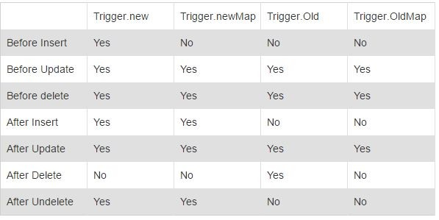
Trigger Events
Beforeinsert: In this Event Trigger will be fired just before Save point in Insert transaction
Beforeupdate: In this Event Trigger will be fired just before Save point in Update transaction
Beforedelete: In this Event Trigger will be fired just before Save point in Delete transaction
Afterinsert: In this Event Trigger will be fired just after Save point in Insert transaction
AfterUpdate: In this Event Trigger will be fired just After Save point in Update transaction
AfterDelete: In this Event Trigger will be fired just After Save point in Delete transaction in after delete oldmap exists
After Undelete:
Syntax
o Trigger sample on object(before insert
,after delete){
//logic
}

Slide 131
Trigger context variables
isExecuting
Returns true if the current context for the Apex code is a trigger, not a Visualforce page, a Web service, or an executeanonymous() API call.
isInsert
Returns true if this trigger was fired due to an insert operation, from the Salesforce user interface, Apex, or the API.
isUpdate
Returns true if this trigger was fired due to an update operation, from the Salesforce user interface, Apex, or the API.
isDelete
Returns true if this trigger was fired due to a delete operation, from the Salesforce user interface, Apex, or the API.
isBefore
Returns true if this trigger was fired before any record was saved.
isAfter
Returns true if this trigger was fired after all records were saved.
isUndelete
Returns true if this trigger was fired after a record is recovered from the Recycle Bin (that is, after an undelete operation from the
Salesforce user interface, Apex, or the API.)

Slide 132
new
Returns a list of the new versions of the sObject records. This sObject list is only available in insert, update, and undelete triggers, and the records can only be modified in before triggers.
newMap
A map of IDs to the new versions of the sObject records. This map is only available in before update, after insert, after update, and after undelete triggers.
old
Returns a list of the old versions of the sObject records. This sObject list is only available in update and delete triggers.
oldMap
A map of IDs to the old versions of the sObject records. This map is only available in update and delete triggers.
size
The total number of records in a trigger invocation, both old and new.

Slide 133

Before Insert
Trigger demo on Account (before insert){ Set<String> accountNames = new Set<String>(); for (Account a : Trigger.New){ accountNames.add(a.name);
}
List<Account> lstAccount = [select id from Account where name in : accountNames]; if (lstAccount.size() > 0){
Trigger.New[0].Name.addError('Account Name already exists');
}
}

Slide 134

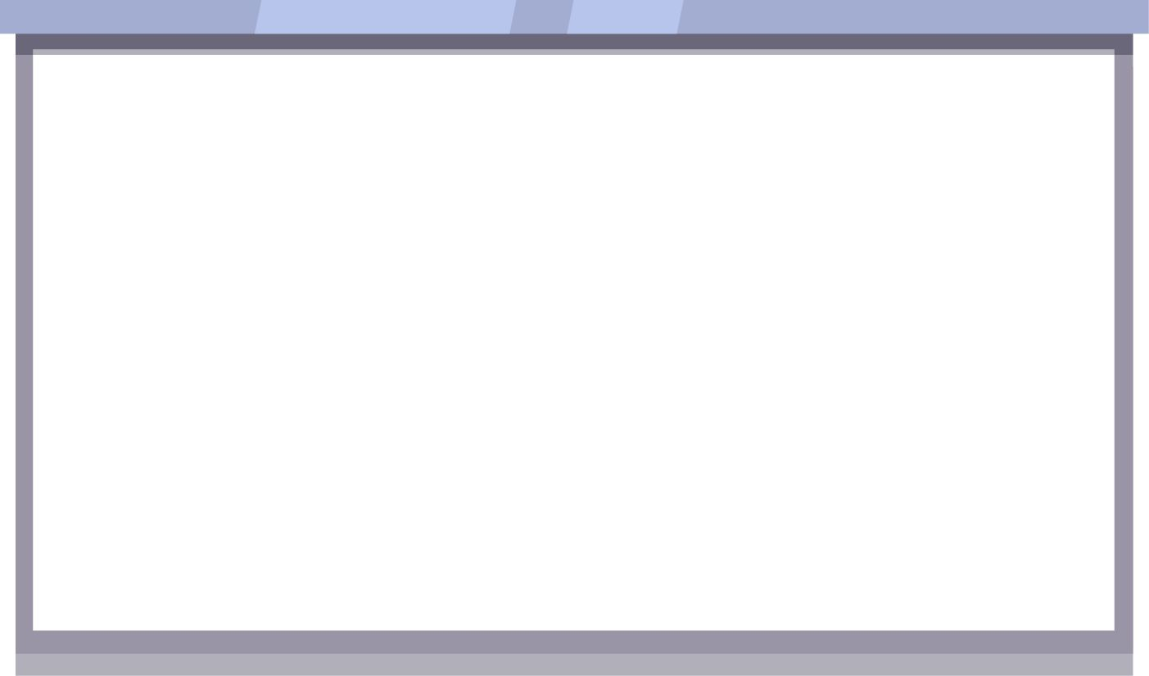

Before Update
The following Trigger will fires when we try to update same the account with same rating trigger before on Account (before update)
{
for(Account a:Trigger.new)
{
List<Account> acc=[Select id from Account where Name=:a.Name and Rating=:a.Rating];
if(acc.size()>0)
{
a.Rating.addError('You Cannot Update Same Rating');
}
}
}

Slide 135





Before Delete
Trigger accdelete on Account (before delete) { for (account a:trigger.old){
if(a.name=='pb')
a.addError('account can not be deleted');
}
}

Slide 136



After Insert
Trigger addprice on Product2 (after insert, after update) { list<product2> plist= trigger.new;
pricebook2 pb= [select id from pricebook2 where isstandard = true]; list<pricebookentry> pricentry= new list();
for(product2 pro: plist){ try{
pricebookentry pricentry = [select id from pricebookentry where product2id=:pro.id and pricebook2id=:pb.id];
}catch(exception e){
pricentry.add(new pricebookentry(product2id=pro.id,pricebook2id=pb.id,unitprice=100));
}
}
insert pricentry;
}

Slide 137


After Update
The following Trigger will fires when we update account phone corresponding contact phone number will update
trigger updatePhoneContact on Account (after update) { list<id>ids = new list<id>();
list<contact>conlist = new list<contact>(); for(account a:trigger.new){
ids.add(a.id);
list<contact>con =[select id,phone,account.phone from contact where accountid in:ids]; for(contact c:con){
c.Phone=c.account.phone; conlist.add(c);
}
update conlist;
}
}

Slide 138
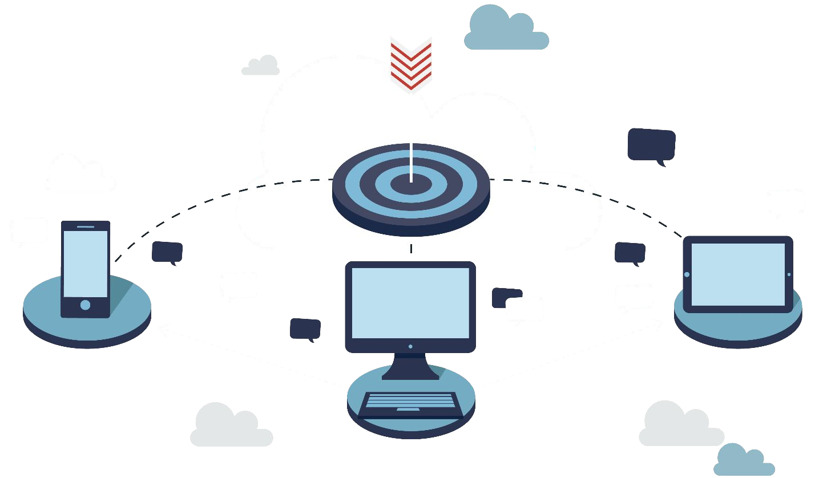
After delete
trigger contactcountonaccount on Contact (after delete) { if(trigger.Isafter && trigger.isDelete){
set<id>idss = new set<id>(); for(contact cc :trigger.old){ idss.add(cc.accountid);
}
list<account>accs = [select name,Number_of_Contacts c,(select lastname from contacts) from account where id in :idss];
for(account aa:accs){
aa.Number_of_Contacts c=aa.contacts.size();
}
update accs;
}
}

Slide 139


Batch Apex…
Batch Apex is used to run large jobs (think thousands or millions of records!) that would exceed normal processing limits. Using Batch Apex, you can process records asynchronously in batches (hence the name, “Batch Apex”) to stay within platform limits
Avoid adding large numbers of batch Apex requests to the asynchronous queue, if possible. If more than 2,000 unprocessed requests from a single organization are in the queue, any additional requests from the same organization will be delayed while the queue handles requests from other organizations.
Tune any SOQL query to gather the records to execute as quickly as possible.
Database.Batchable interface has the following three methods that need to be implemented −
Start Execute Finish

Slide 140

Batch Apex
When to use Batch Apex ?
When you want to process large number of records on daily basis or even on specific time of interval then you can go for Batch Apex.
Also, when you want an operation to be asynchronous then you can implement the Batch Apex. Batch Apex is exposed as an interface that must be implemented by the developer. Batch jobs can be programmatically invoked at runtime using Apex. Batch Apex operates over small batches of records, covering your entire record set and breaking the processing down to manageable chunks of data.

Slide 141
Start Method: The Start method is one of the three methods of the Database.Batchable interface
global void execute(Database.BatchableContext BC, list<sobject<) {}
Use the Database.QueryLocator object when you are using a simple query to generate the scope of objects used in the batch job.
In this case, the SOQL data row limit will be bypassed.
Execute Method: Let us now understand the Execute method of the Database.Batchable interface.
Syntax
global void execute(Database.BatchableContext BC, list<sobject<) {} where, list<sObject< is returned by the Database.QueryLocator method.
This method gets called after the Start method and does all the processing required for Batch Job.
Finish Method:We will now discuss the Finish method of the Database.Batchable interface.
Syntax
global void finish(Database.BatchableContext BC) {}
This method gets called at the end and you can do some finishing activities like sending an email with information
about the batch job records processed and status.

Slide 142
Area | Normal Context | Batch Context
SOQL queries | 100 SOQL per cycle | 200 SOQL per cycle
records retrieved by SOQL queries | 50,000 | 50,000,000 (getQueryLocator)
executed code statements | 200,000 | 1,000,000 (Winter '14)
Heap size | 6 MB | 12 MB
global class ExampleBatchClass implements Database.Batchable<sObject>{ global ExampleBatchClass(){
// Batch Constructor
}
// Start Method global Database.QueryLocator start(Database.BatchableContext BC){ return Database.getQueryLocator(query);
}
// Execute Logic global void execute(Database.BatchableContext BC, List<sObject>scope)
{
// Logic to be Executed batch wise
}
global void finish(Database.BatchableContext BC){
// Logic to be Executed at finish
//call anther batch job
//Send email notification
}
}

Slide 143


Introduction to Test Class
Test Classes In Apex for Unit Testing. We get to find the bugs in our code and fix it to give better output. Testing gives the Code Coverage
In SFDC, the code must have 75% code coverage in order to be deployed to Production. This code coverage is performed by the test classes. Test classes are the code snippets which test the functionality of other Apex class.
A test class with one test method. You also run the test and verify code coverage. The test method exercises and validates the code in the trigger and class. Also, it enables you to reach 100% code coverage for the trigger and class.
Syntax
@isTest
private class CustomerTriggerTestClass { static testMethod void myUnitTest() {
// logic here
}
}

Slide 144

Creating Test Class
@isTest annotation:The test class are written under @isTest annotation. By using this annotation for test class we maintain code limit as it is not counted in it.
Create Raw-Data At First::The Test Class In Apex Salesforce does not have access to any of the data which is stored in the related Salesforce org by default.We need to create raw-data for test class in our test class itself. By adding SeeAllData=true to @isTest annotation i.e. @isTest(SeeAllData=true) grants the access to the all the data of the related Salesforce org.
@isTest annotation: By using this annotation, you declared that this is a test class and it will not be counted against the organization's total code limit.
testMethod keyword: Unit test methods are the methods which do not take arguments, commit no data to the database, send no emails, and are declared with the testMethod keyword or the isTest annotation in the method definition. Also, test methods must be defined in test classes, that is, classes annotated with isTest.
Test.startTest() and Test.stopTest():These are the standard test methods which are available for test classes. These methods contain the event or action for which we will be simulating our test. Like in this example, we will test our trigger and helper class to simulate the fire trigger by updating the records as we have done to start and stop block. This also provides separate governor limit to the code which is in start and stop block.
System.assert():This method checks the desired output with the actual. In this case, we are expecting an Invoice record to be inserted so we added assert to check the same.

Slide 145
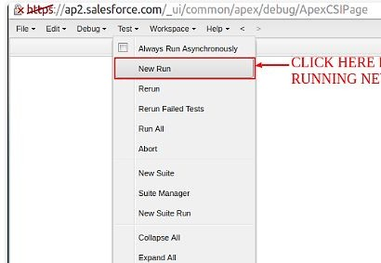
Running the Test Class…
Follow the steps given below to run the test class −
Step 1 − Go to Apex classes ⇒ click on the class name 'CustomerTriggerTestClass'.
Step 2 − Click on Run Test button as shown.

Slide 146
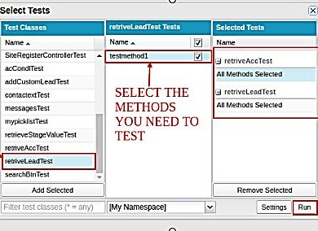
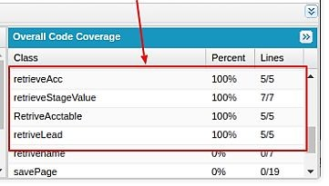

Running the Test Class
THIS COLUMN SHOWS THE TEST CLASS AND METHODS SELECTED
PERCENTAGE OF CODE COVERED OF ACTUAL CLASS
SELECT THE METHODS YOU NEED TO TEST
ALL THE TEST CLASSES YOU NEED TO RUN
AFTER SELECTION CLICK HERE

Slide 147

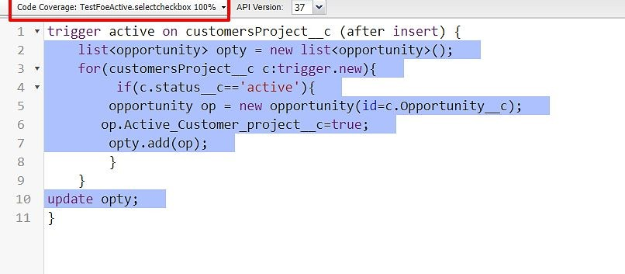

How to know Percentage Covered
Go to apex-search apex name
The code is coverage which line are highlighted with Blue color
The code is not covered is highlighted in Red color

Slide 148




Best Practice for writing Test class…
At least 75% of your Apex code must be covered by unit tests, and all of those tests must complete successfully. But this should not be our focus. We should aim for 100% code coverage, which ensures that you cover each positive and negative use case of your code to cover and test each and every branch of your code.
Calls to System. debug are not counted as part of Apex code coverage.
Test methods and test classes are not counted as part of Apex code limit. So, no worries about writing long test class with more methods just to make sure that all your code branches are covered.
Every trigger you are trying to deploy should have at least 1% coverage, but yes overall coverage of your production org after getting your code deployed should be 75%, otherwise Salesforce won’t let you deploy your code.
Class can be deployed on 0% coverage as well, but as I told in last point, that overall coverage of your production org after getting your code deployed should be 75%, otherwise Salesforce won’t let you deploy your code.
All test methods should reside in a separate class from the class in which the method being tested resides.

Slide 149
Lightning Web Component (LWC) Fundamentals
Lightning Web Components (LWC) is a modern framework by Salesforce for building dynamic web applications on the Salesforce platform. It leverages web standards, making it a more lightweight and performant alternative to Aura Components.

Slide 150
Understanding LWC:
Web Standards:
LWC is built on top of modern web standards like Web Components, Custom Elements, Shadow DOM, and ES6 modules.
It encourages the use of vanilla JavaScript, CSS, and HTML, making it easier for developers with standard web development skills to adapt.
Component-Based Architecture:
LWC promotes a modular approach to development, where each piece of functionality is encapsulated in a component.
Components can be reused, nested, and composed to build complex UIs.

Slide 151
Reactive Data Binding:
LWC uses a reactive data binding system, where changes in data are automatically reflected in the UI.
This is achieved through reactive properties (@track, @api, @wire) that manage data flow between components and the Salesforce backend.
Interoperability with Aura Components:
LWC can coexist with Aura components, allowing for gradual migration and reuse of existing components.
Aura components can contain Lightning web components. However, the opposite doesn't apply. Lightning web components can't contain Aura components.

Slide 152
Setting up the Development Environment
1. Salesforce Developer Org Setup:
Sign Up for a Developer Org:
Go to developer.salesforce.com and sign up for a free Developer Org if you don't have one.
Login to Your Salesforce Org:
After signing up, log in to your Developer Org through the Salesforce website.
2. Install Visual Studio Code (VS Code):
Download VS Code:
Visit the Visual Studio Code website and download the appropriate version for your operating system.
Install Salesforce Extensions for VS Code:
Open VS Code.
Click on the Extensions icon on the left-hand sidebar (or press Ctrl+Shift+X).
In the search bar, type "Salesforce Extension Pack" and click Install.

Slide 153
3. Install Salesforec CLI
In internet search for salesforce cli and install it. It is used for connection between vscode and Salesforce Org
4. Set Up Your Salesforce Project in VS Code:
Open VS Code:
Launch VS Code after installing the Salesforce extensions.
Create a New Project:
In VS Code, click on View in the menu and select Command Palette.
In the Command Palette, type SFDX: Create Project and select it.
Choose Standard for the project type.
Enter a project name and select a location on your computer to save it.

Slide 154
5. Authenticate Your Org:
Open Command Palette:
In VS Code, click on View and select Command Palette.
Authorize an Org:
Type SFDX: Authorize an Org in the Command Palette.
Select Production for a Developer Org.
This will open a browser window where you can log in to your Salesforce org. After logging in, your org is connected to your VS Code project.
6. Create a Lightning Web Component :
Go to the project which we created go to LWC folder -> right click(create SFDX:create lightning web component).

Slide 155
Hello World Component
helloworld.html
<template>
<div data-name = "Eric">Username</div>
<div id="myElement">Hello, World!</div>
<div style="color: blue; font-size: 16px;">Hello, World!</div>
<div class ="hello-world-container">
<strong>This text is important!</strong>
<input type="radio" id="html" name="fav_language" value="HTML">
<label for="html">HTML</label><br>
<input type="radio" id="css" name="fav_language" value="CSS">
<label for="css">CSS</label><br>
<input type="radio" id="javascript" name="fav_language" value="JavaScript">
<label for="javascript">JavaScript</label><br><br>
<input type="submit" value="Submit">
<p>My mother has <span style="color:blue">blue</span> eyes.</p>
<a href="https://www.google.com">Click me!</a>
<ul style="list-style-type:circle">
<li>Coffee</li>
<li>Tea</li>
<li>Milk</li>
</ul>
<h1> Hello, {firstname} </h1>
<p>Current time: {currenttime}</p>
<button onclick={handleclick}> clickme! </button>
</div>
</template>

Slide 156
// Import the necessary LightningElement and api decorators from the 'lwc' module
import { LightningElement, api } from 'lwc';
// Export the default class 'Helloworld' which extends LightningElement, making it an LWC component
export default class Helloworld extends LightningElement {
// @api decorator makes the 'firstname' property public, meaning it can be set from outside the component
// 'firstname' is initialized with a default value of "World"
@api firstname = "World";
// 'currenttime' property holds the current time in a human-readable string format
// The 'toLocaleTimeString()' method formats the time based on the user's locale
currenttime = new Date().toLocaleTimeString();
// 'handleclick' is a method that changes the 'firstname' property to 'Salesforce!'
// This method will likely be called in response to a user interaction, such as a button click
handleclick() {
this.firstname = 'Salesforce!';
}
}

Slide 157
<?xml version="1.0" encoding="UTF-8"?>
<!-- Root element for the Lightning Component Bundle, which defines the metadata for the LWC -->
<LightningComponentBundle xmlns="http://soap.sforce.com/2006/04/metadata">
<!-- Specifies the API version this component is using. This ensures compatibility with Salesforce's platform version -->
<apiVersion>56.0</apiVersion>
<!-- Indicates whether the component is exposed (available) for use in the Lightning App Builder and other interfaces -->
<isExposed>true</isExposed>
<!-- Defines the targets where this component can be used, such as App, Record, and Home pages -->
<targets>
<!-- Makes the component available for use on Lightning App Pages -->
<target>lightning__AppPage</target>
<!-- Makes the component available for use on Lightning Record Pages (like object detail pages) -->
<target>lightning__RecordPage</target>
<!-- Makes the component available for use on the Lightning Home Page -->
<target>lightning__HomePage</target>
</targets>
</LightningComponentBundle>

Slide 158
.hello-world-container {
background-color: #ff0000;
margin: 10px;
padding: 20px;
border-radius: 50px;
}
h1 {
font-size: 30px;
color: #00d223;
}

Slide 159
Component Bundle
In Salesforce Lightning Web Components (LWC), a "Component Bundle" refers to the collection of files that together define and implement a Lightning Web Component. Each component bundle typically includes several key files, each serving a specific purpose in defining the component's behavior, appearance, and integration with Salesforce. Here's a breakdown of what you might find in an LWC component bundle:

Slide 160
1. JavaScript File (.js)
Purpose: Contains the logic for the component, including properties, methods, and event handling.
Naming: The file is named after the component, e.g., myComponent.js.
2. HTML File (.html)
Purpose: Defines the component's template, which includes the structure and layout of the component using HTML.
Naming: The file is named after the component, e.g., myComponent.html.
3. CSS File (.css)
Purpose: Contains styles specific to the component.
Naming: The file is named after the component, e.g., myComponent.css.
4. XML Configuration File (.xml)
Purpose: Describes the component's metadata, including where the component can be used (e.g., in an App Builder, a Record Page, or as a Quick Action).
Naming: The file is named after the component, e.g., myComponent.js-meta.xml.

Slide 161
Lifecyclehooks
Here’s a practical example of using lifecycle hooks in a Salesforce Lightning Web Component (LWC). The example will demonstrate various lifecycle hooks including constructor, connectedCallback, renderedCallback, disconnectedCallback, and errorCallback.
Example Component: lifecyclehooks
Purpose: This component will:
Initialize state and properties in constructor.
Fetch data when the component is added to the DOM in connectedCallback.
Manipulate the DOM after rendering in renderedCallback.
Clean up resources when removed from the DOM in disconnectedCallback.
Handle any errors that occur in errorCallback.

Slide 162
Explanation
constructor():
Initializes the component and logs a message to the console.
Typically used for setting initial values and preparing the component.
connectedCallback():
Fetches data when the component is added to the DOM and logs a message.
Ideal for making server requests or setting up component state.
renderedCallback():
Logs a message every time the component is rendered or re-rendered.
Useful for performing DOM manipulations or interacting with third-party libraries.
disconnectedCallback():
Logs a message when the component is removed from the DOM.
Used for cleanup tasks such as removing event listeners or stopping timers.
errorCallback():
Logs errors and stack traces when an error occurs.
Allows for custom error handling and displaying error messages.

Slide 163
Lifecyclehooks.html
<template>
<div>
<h1>Lifecycle Hooks Demo</h1>
<p>Data from the server: {data}</p>
<button onclick={handleClick}>Click Me</button>
<template if:true={error}>
<p>Error: {error.message}</p>
</template>
</div>
</template>

Slide 164
import { LightningElement, track, api } from 'lwc';
export default class Lifecyclehooks extends LightningElement {
@track data = 'Loading...'; // State variable to hold the data fetched from the server
@track error; // State variable to hold any error information
// Constructor is called first when the component is instantiated
constructor() {
super(); // Call the parent class constructor
console.log('Constructor: Component is being constructed');
// Initialize properties or state here if needed
}
// connectedCallback is called when the component is inserted into the DOM
connectedCallback() {
console.log('ConnectedCallback: Component is connected to the DOM');
// Typically used for initialization work that requires the component to be in the DOM
// Here, we're simulating a data fetch from a server
this.fetchData();
}
// fetchData is an asynchronous method that simulates a server call
async fetchData() {
try {
// Simulate a server call with a timeout, resolving the promise after 2 seconds
const response = await new Promise((resolve, reject) =>
setTimeout(() => resolve('Fetched data from server'), 2000)
);
this.data = response; // Update the state with the fetched data
} catch (error) {
this.error = error; // If an error occurs, store it in the error state variable
}
}
// renderedCallback is called after every render of the component
renderedCallback() {
console.log('RenderedCallback: Component has been rendered or re-rendered');
// This hook is useful for performing DOM manipulations or initializing third-party libraries
}
// disconnectedCallback is called when the component is removed from the DOM
disconnectedCallback() {
console.log('DisconnectedCallback: Component has been removed from the DOM');
// Clean up resources, like removing event listeners or canceling timers
}
// errorCallback is called when an error occurs during rendering or in one of the lifecycle hooks
errorCallback(error, stack) {
console.error('ErrorCallback: An error occurred', error);
console.error('Stack trace:', stack);
this.error = error; // Store the error in the error state variable for display in the component
}
// Example method to demonstrate interaction; could be triggered by a button click
handleClick() {
console.log('Button clicked');
// This is where you'd handle user interactions, such as button clicks
}
}

Slide 165
Data Binding
Data binding in Salesforce Lightning Web Components (LWC) is a way to bind data between the JavaScript class and the HTML template. LWC supports both one-way and two-way data binding, allowing developers to create dynamic and interactive user interfaces.
1. One-Way Data Binding(parent to child communication)
One-way data binding means that data flows in a single direction, typically from the JavaScript controller to the HTML template. This is the default behavior in LWC.

Slide 166
childcomponent.html
<template>
<lightning-card title ='this is child'></lightning-card>
<lightning-card title ={getmessage}></lightning-card>
</template>

Slide 167
import { LightningElement, api } from "lwc";
export default class ChildComponent extends LightningElement {
@api getmessage;
}

Slide 168
Parentcomponent.html
<template>
<lightning-card title ='this is parent'></lightning-card>
<c-childComponent
getmessage = {message}
></c-childComponent>
</template>

Slide 169
import { LightningElement, api } from "lwc";
export default class ParentComponent extends LightningElement {
message = 'Hello from parent';
}

Slide 170
2. Two-Way Data Binding(Child to parent communication)
Two-way data binding in LWC typically involves input elements like text fields, checkboxes, or radio buttons. When a user interacts with an input element, the corresponding JavaScript property is updated automatically, and changes to the JavaScript property can update the input element

Slide 171
Child1.html
<template>
<lightning-input
onchange={handleChnage}
type="number"
name="input1"
label="Enter a number"
></lightning-input>
</template>

Slide 172
import { LightningElement, api } from 'lwc'; // Importing the base LightningElement class and api decorator from LWC
export default class Child1 extends LightningElement {
@api progressValue; // Declaring a public property 'progressValue' that can be set from a parent component
handleChnage(event) { // Event handler method triggered when the input value changes
this.progressValue = event.target.value; // Updating 'progressValue' with the value from the event's target (e.g., an input field)
// Creates a custom event named 'progressvaluechange' and passes 'progressValue' as event detail
const selectedEvent = new CustomEvent("progressvaluechange", {
detail: this.progressValue
});
// Dispatches the custom event, allowing parent components to listen for this event
this.dispatchEvent(selectedEvent);
}
}

Slide 173
Parent1.html
<template>
<lightning-card title="Getting Data From Child">
<p class="slds-p-horizontal_small">
<lightning-progress-bar
value={progressValue}
size="large"
></lightning-progress-bar>
<c-child1
onprogressvaluechange={hanldeProgressValueChange}
></c-child1>
</p>
</lightning-card>
</template>

Slide 174
import { LightningElement, track } from 'lwc';
export default class Parent1 extends LightningElement {
@track progressValue = 0;
hanldeProgressValueChange(event) {
this.progressValue = event.detail;
}
}

